Slide 1
Week 8 Notes

Slide 2
Division of Power
Denied powers – things states, feds aren’t allowed to do
Fed: tax exports (goods made in US and sold abroad), interfere with state responsibilities
State: make treaties with other countries, coin $$, etc.

Slide 3
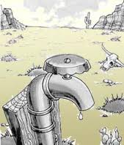
Division of Power
Between states: Full faith and credit given to decisions of other states
Extradition: criminals face trial in state they committed crime
Licenses, certificates issued in one state recognized by others
Interstate compacts: written
agreements between states, settle
disputes
Ex. Water rights

Slide 4
Division of Power
Growth of National Power: justified under war power, power to regulate interstate commerce, power to tax and spend
Intervention in education justified as necessary to protect country
Civil Rights laws against discrimination in restaurants, hotels justified under commerce clause
Sin taxes – govt taxes goods that are bad for you

Slide 5
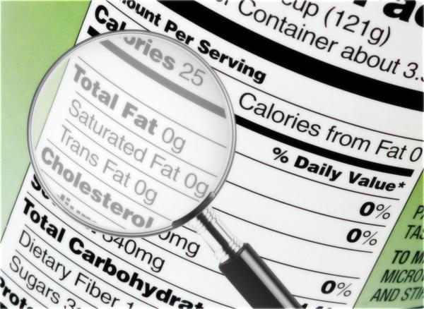
Division of Power
Growth of National Power cont.
Fed govt gives aid to states, can place requirements on that aid
Preemption – fed govt ability to take over a state function
Ex. Nutritional Labeling and Education Act made food labeling a federal power

Slide 6
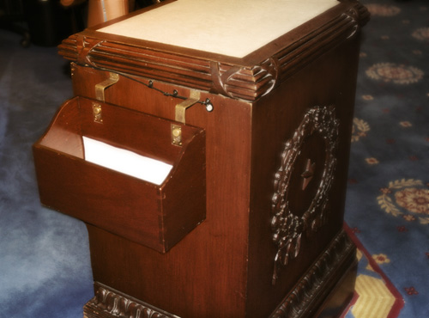
Legislature at Work – How a Bill Becomes a Law
Bill – proposed law
1. Step 1: Introduction: Anyone can write a bill, but only members of Congress can introduce a bill
To introduce in House, bill dropped into hopper, a ceremonial box
To introduce in Senate, Senator is recognized by presiding officer, then reads bill to rest of Senate

Slide 7
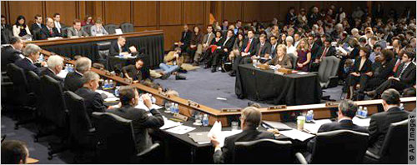
How a Bill Becomes a Law
Step 2: Committee: Once introduced, bill is given title and #, sent to committee
Committee can reject bill, amend it, or recommend its adoption
Step 3: Hearing: committee holds hearing to hear expert testimony on bill
Make changes, vote on passage

Slide 8
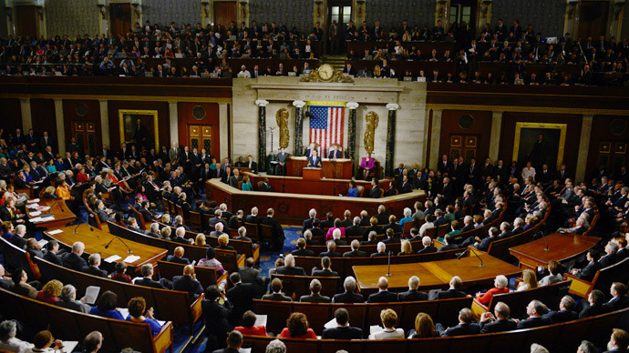
How a Bill Becomes a Law
Step 4: Floor Action: debate between lawmakers in Senate and/or House and vote on passage
Step 5: Other House: once its passed 1 house of Congress, must go to other and be passed in the same form
Conference committee is called if 2 groups can’t agree

Slide 9
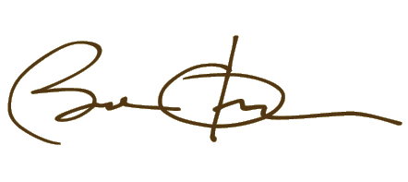
How a Bill Becomes a Law
Step 6: Presidential signature: president must sign or veto bill
Congress can override with a 2/3 majority
Step 7: Registration: law is registered
Ex. P.L. 114-25

Slide 10
Bills and Laws
Resolutions: type of bill used to make policy on unusual, temporary matters, no presidential signature needed
simple resolution: rule change for 1 house of Congress, only needs to pass that house
Joint resolution: used to make corrections to earlier laws, introduce a constitutional amendment, must pass both houses

Slide 11
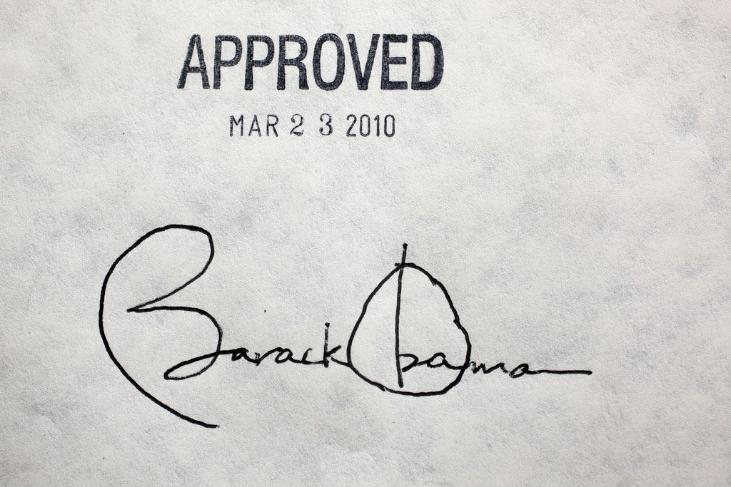
Bills and Laws
Only 10% of all bills pass
Long, complicated process
Lots of chances to kill it
Lawmakers must compromise

Slide 12
House Leadership
Speaker of the House – leader of majority party, presiding officer
Determines what legislation is heard and when
Majority/minority whip – charged with drumming up votes from the party for legislation
Majority/minority whips

Slide 13
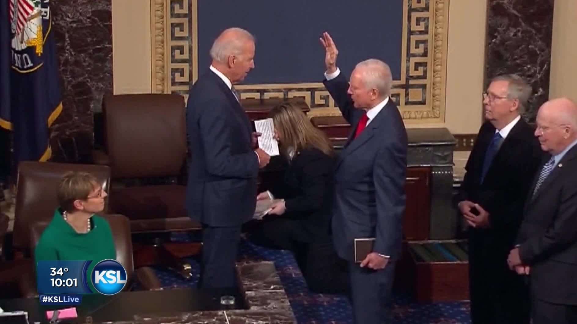
Senate Leadership
Vice President presides – can’t vote unless there’s a tie
President pro tempore fills in when VP is not there
Majority/minority leaders represent party interests along with whips

Slide 14
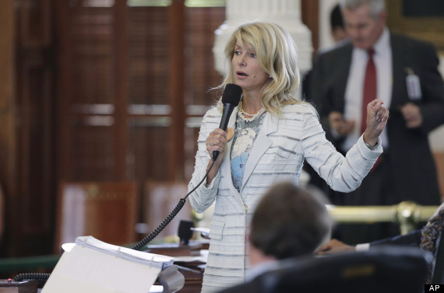
House and Senate Quirks
All revenue bills, those regarding taxes, must originate in House
House Ways and Means Committee very powerful
In Senate, Senators can defeat a bill by filibuster, or refusing to end debate on a bill
To end filibuster, must have 60 votes

Slide 15
Filibuster
https://www.youtube.com/watch?v=HX8aFpnWxPA

