Slide 1
Week 5 Notes: 9/28-10/2

Slide 2
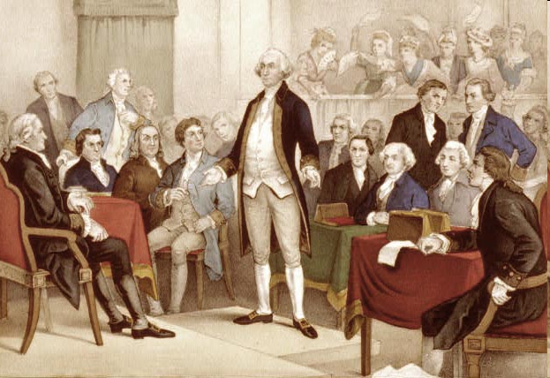
Federal Legislature
Terms and Sessions of Congress
Term = length of time between elections in Congress (2 years)
Each term has 2 sessions
President can call a special session

Slide 3
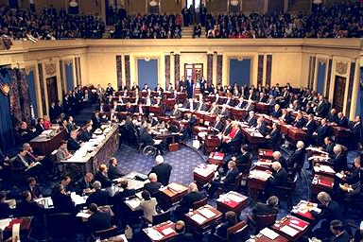
The Senate
100 members: 2 per state
6-year terms staggered - 1/3 of Senate elected every 2 years
no limit on terms
Requirements: 30 years old, citizen for 9 years, live in state they represent

Slide 4
House of Representatives
435 members, number per state based on pop.
Each state has at least 1 (WY, NE, ND, SD)
2 year terms, no limit on # of terms
Reapportionment = every 10 years based on census

Slide 5
House of Representatives
District = area a representative serves
State govt. creates districts
Gerrymandering = when state govts redraw district lines to favor their party

Slide 6
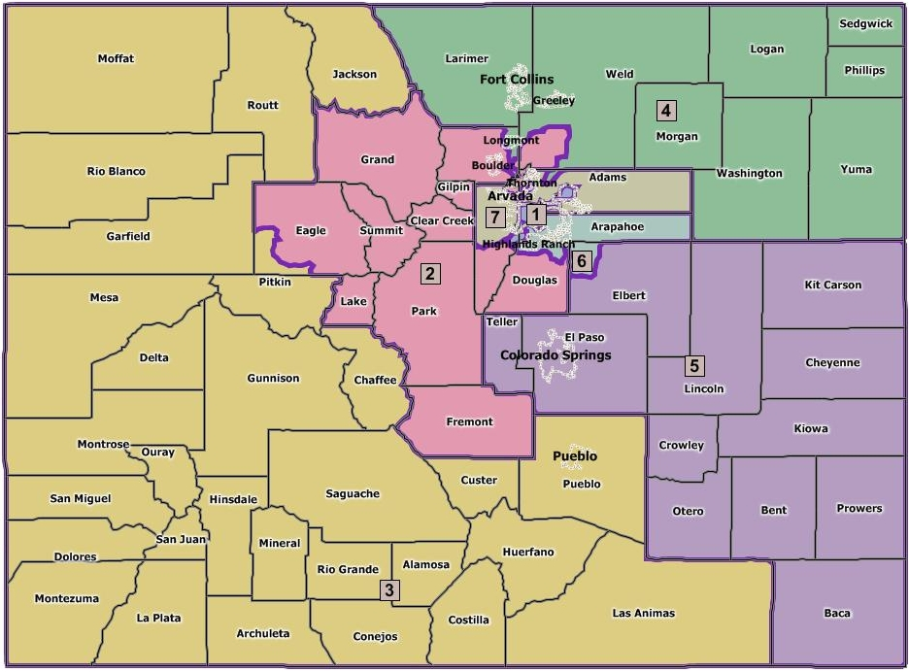

Slide 7
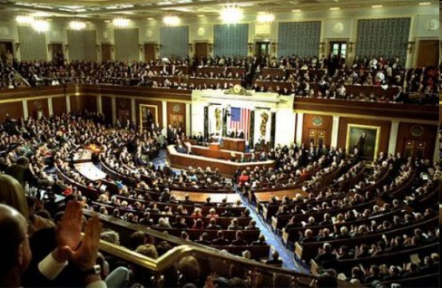
House of Representative
Requirements: 25 years old, citizen for 7 years, inhabitant of state

Slide 8
Congressional Members
Average member = white male in mid-50s
Married, has children, Christian
Lawyers, though some have backgrounds in business, education, agriculture, journalism, or professional politics

Slide 9
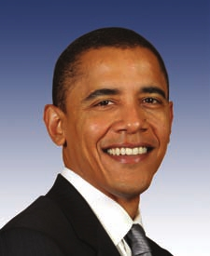
Executive Branch
Enforces Laws
Checks on Legislature: veto power, executive orders
Checks on Judicial: appoints federal judges, pardon/reprieve/amnesty power

Slide 10
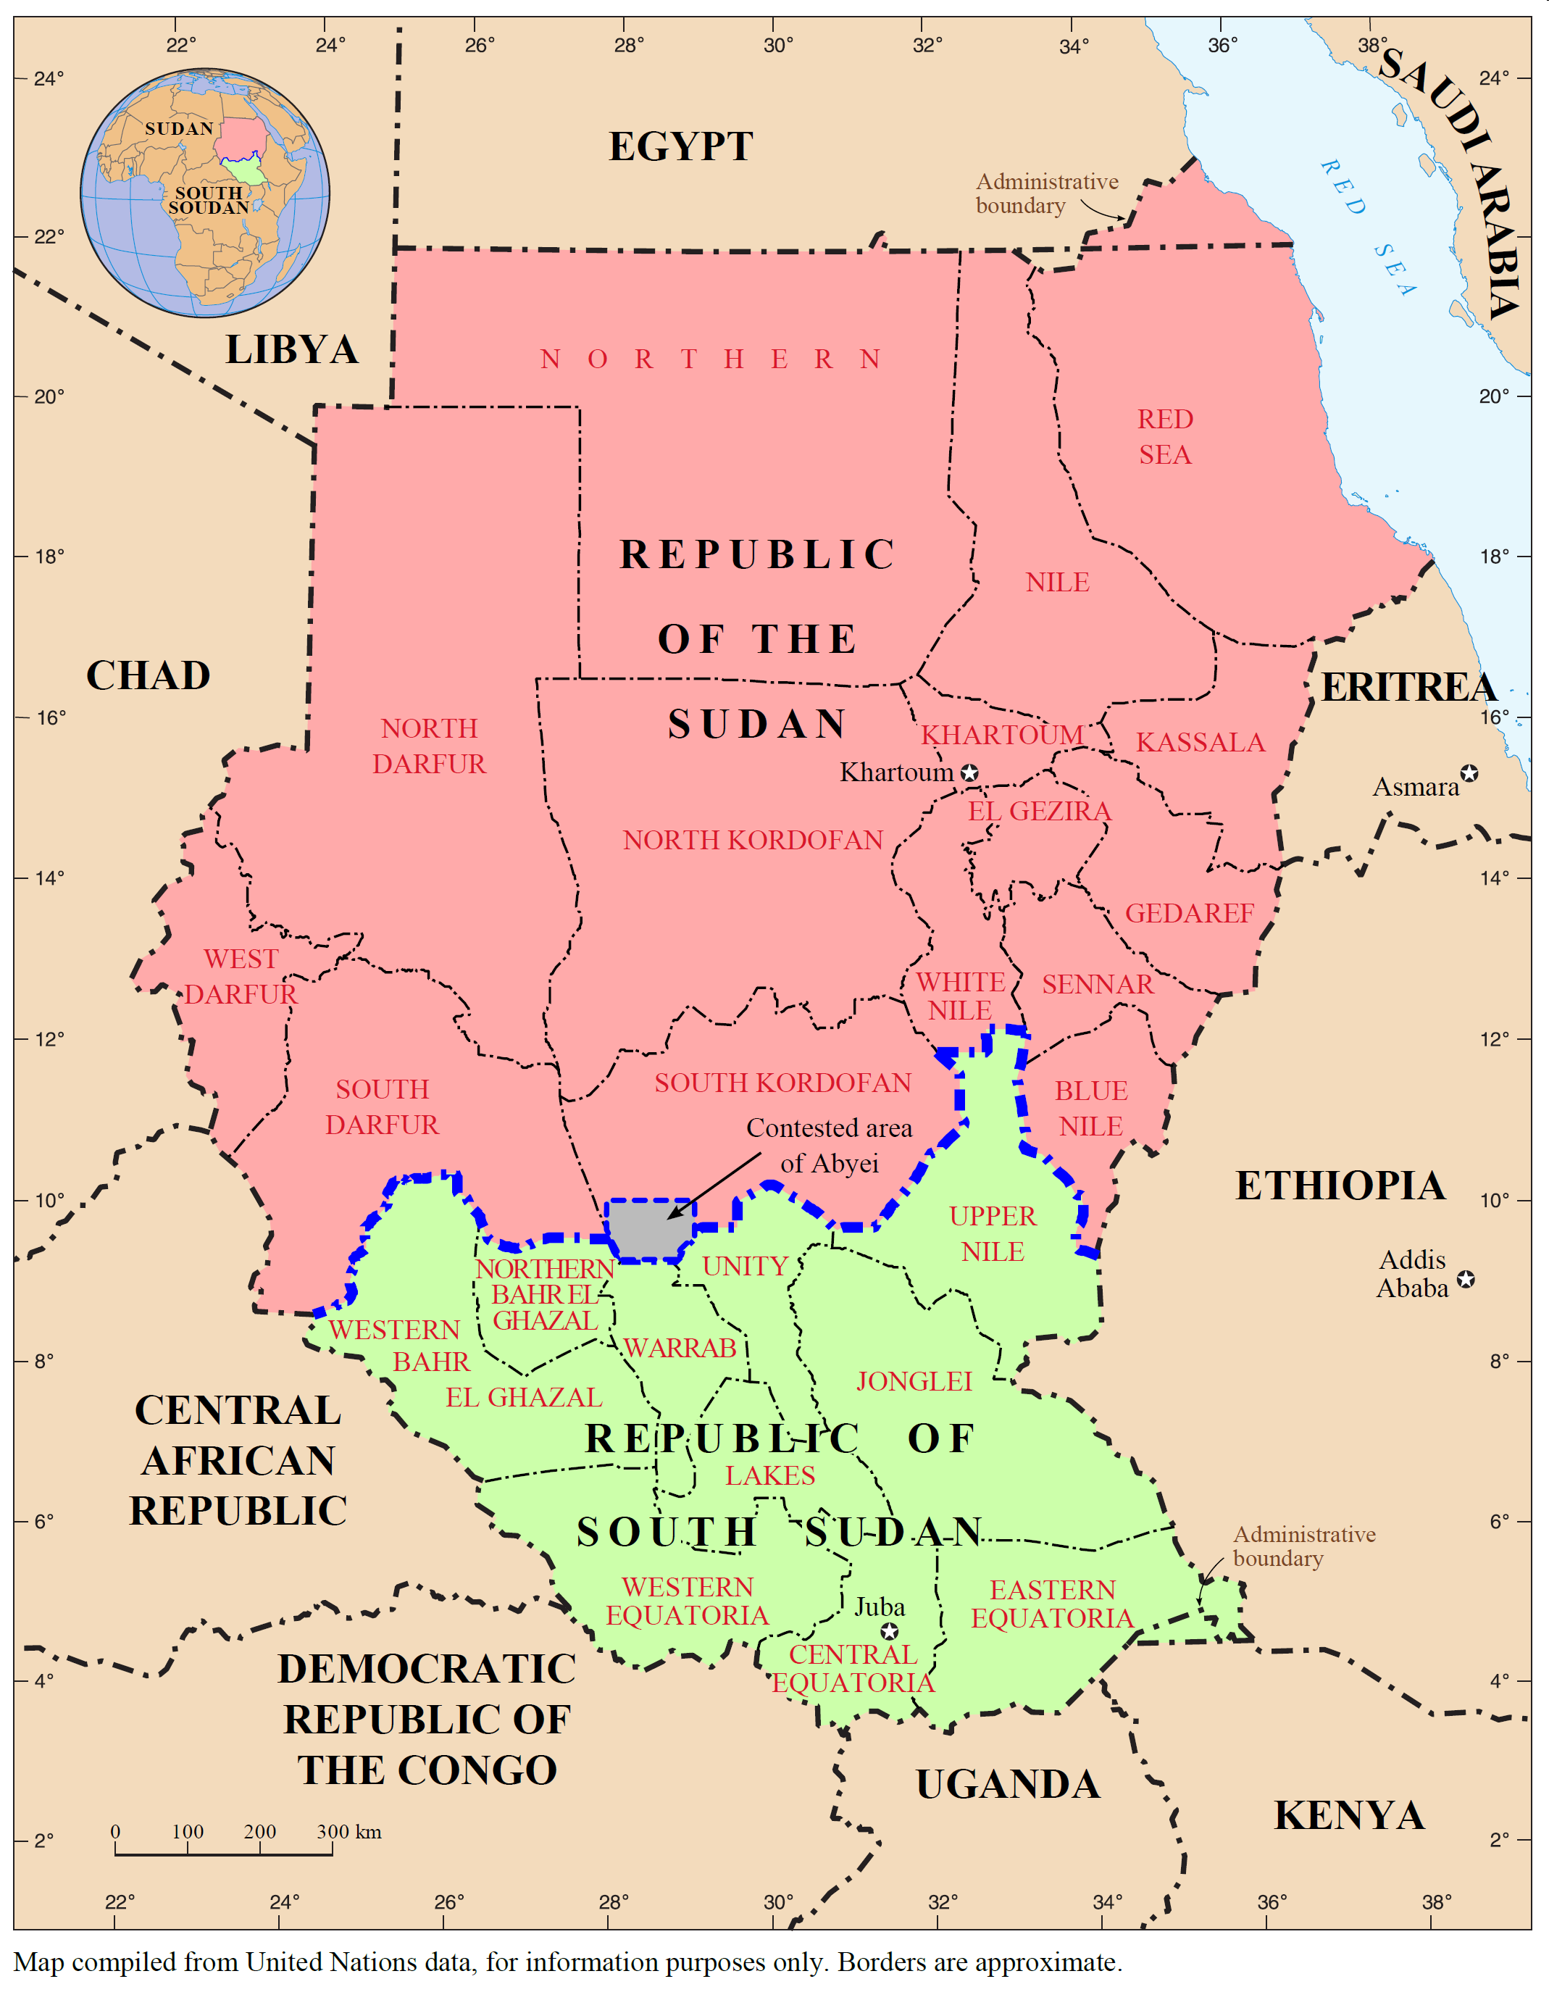
Roles of President
Commander in Chief
Directs armed forces
Economic Role
Proposes a budget
Diplomatic Role
Foreign policy director
Signs Treaties
Recognizes foreign governments

Slide 11
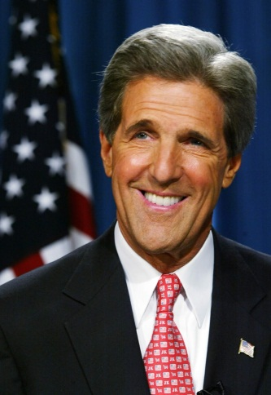
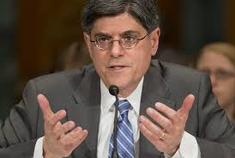
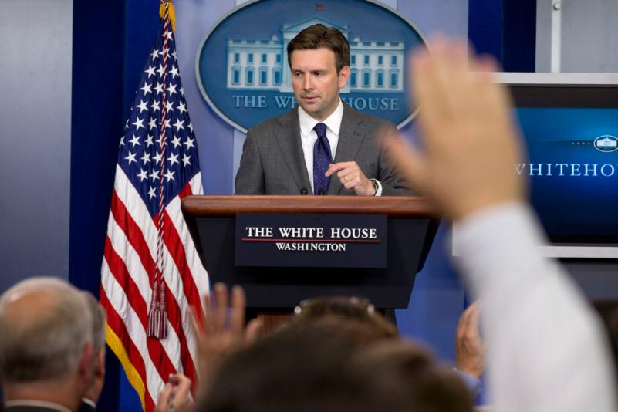
The President’s Cabinet
Heads of departments
Experts and advisors
Key players:
Secretary of State
Attorney General
Secretary of the Treasury
Press Secretary

Slide 12
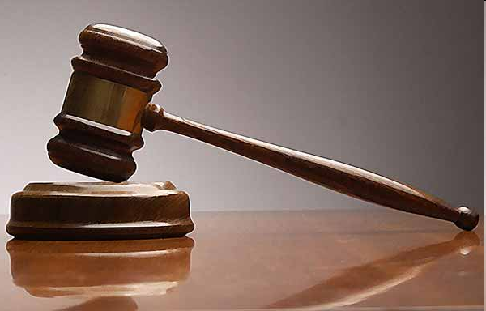
Judicial Branch
Role: Interprets laws, punishes law breakers
Highest court: Supreme Court
Federal, state, municipal courts underneath
Appeals Courts: can overturn decisions of lower courts

Slide 13
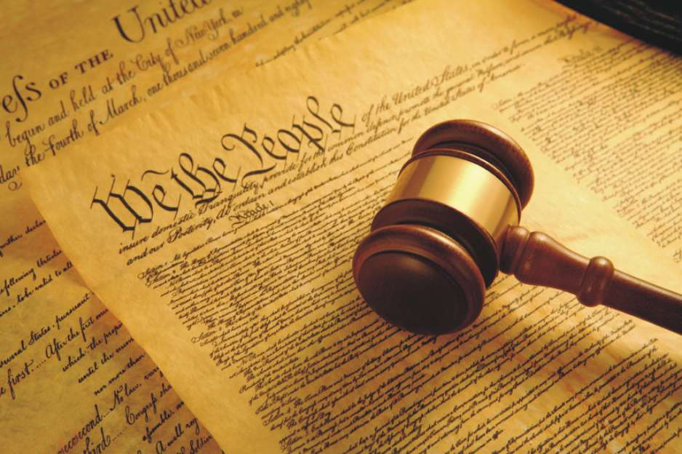
Judicial Branch
Supreme Court: only handle constitutional issues
9 justices
appointed by president, approved by Congress
serve for life
Power of judicial review, can interpret Constitution
Marbury v. Madison

Slide 14
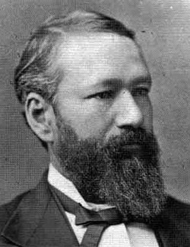
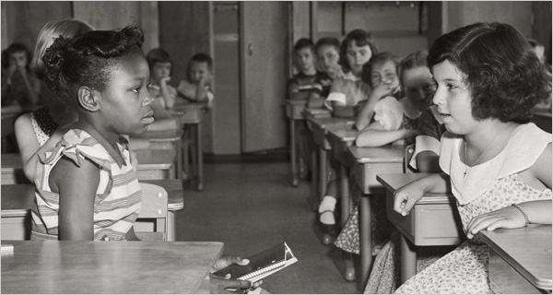
Considering Precedent
Precedent: previous cases about the same kind of issues
Often used to help make decisions (how was this kind of issue decided in the past?)
EXAMPLE: Brown v. Board of Education overturned the precedent set by Plessy v. Ferguson

