Slide 1
Week 33 Notes

Slide 2
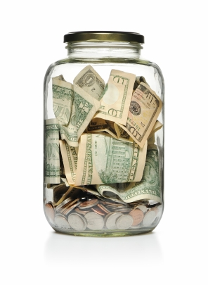
Saving and Investment
Checking account:
Advantages: safe, high liquidity (easy to access money, debit cards)
Disadvantage: no interest paid
Savings account:
Advantages: safe, earn interest
Disadvantages: less liquidity (near money, must visit bank to access $$)

Slide 3
Saving and Investment
Retirement accounts:
Generally low liquidity – can’t access $$ until retirement
401(k): employer sponsored accounts
Individual Retirement Accounts (IRAs): private accounts

Slide 4
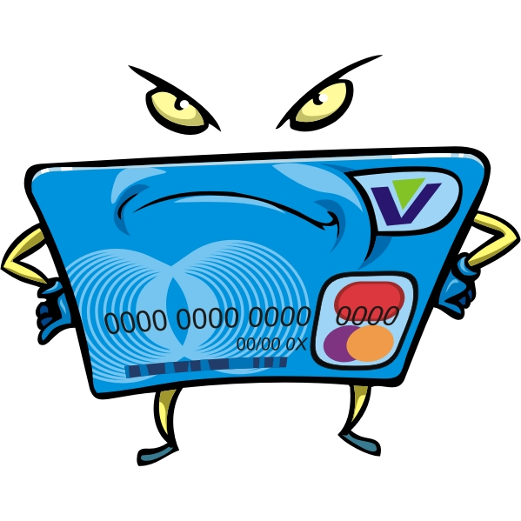
Credit
Credit: your ability to buy now, pay later
Loans
Pay interest
Cost of credit determined by:
Annual Percentage Rate (APR): interest charged per year
Length of loan
How often you make payments

Slide 5
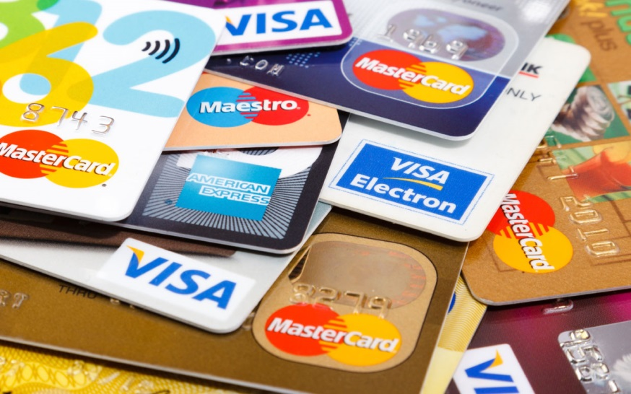
Credit
Choosing a credit card:
Annual fees – not all have one
Interest Rate: fixed (won’t change), variable (subject to change) (APR)
Grace Period: time between bill date and due date
Minimum Payment: flat amount or % of balance
Credit Limit: max amt you can charge
Other fees
Bonuses: rewards programs, cash back, etc.

Slide 6
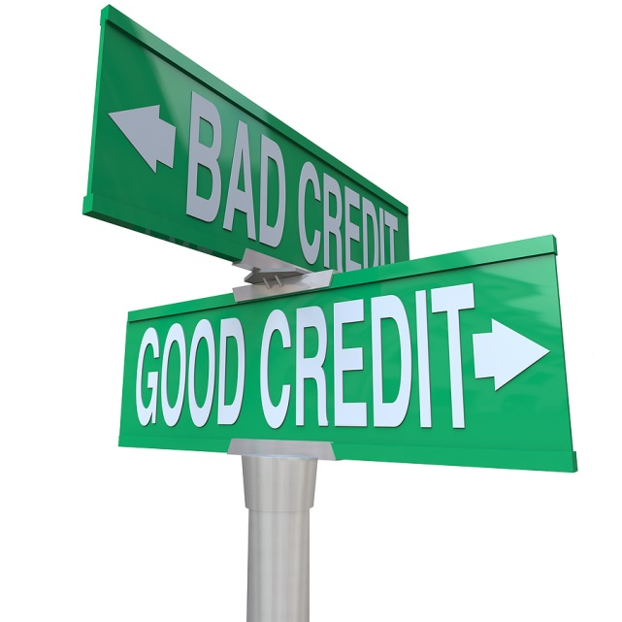
Credit
What is your personal “credit?”
Determined by:
Paying bills on time
Your income
Your capital: Other assets (home, car, etc.)

Slide 7
App 1: Credit Card Comparison
Take a look at your credit card application and make a T-chart comparing the following:
Annual Percentage Rate (make sure to note if it’s fixed or variable)
Annual fee
Penalty fees
Rewards
Transaction fees (foreign and domestic)
Grace periods
Variability depending on credit score
****Now compare with your group – decide which would be the best credit card based on your comparison

Slide 8
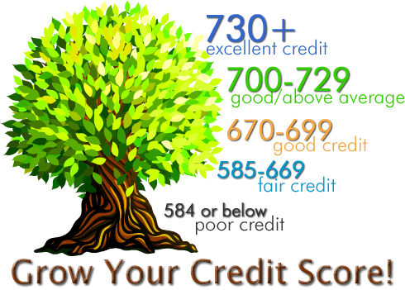
Credit
Credit reports: details person’s credit record
Equifax, Experian, Trans Union = 3 top providers
1 free copy per company per year
Credit score – number indicating your credit worthiness
Different agencies use different scores, higher = better

Slide 9
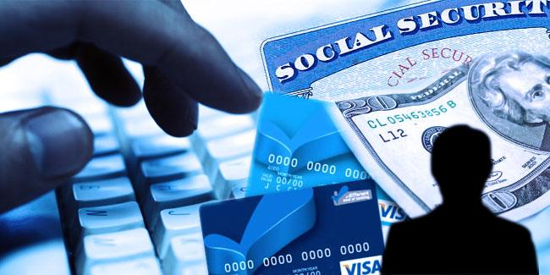
Credit
Identity theft: use of personal information to commit fraud
Soc. Security #, credit card/bank account #s
How it happens: hacking, dumpster diving, spamming, shoulder surfing
If it happens to you:
Immediately put out a fraud alert on your personal info, cancel credit cards, etc.

Slide 10
App 2: Podcast on Credit Card Black Market
1. How do you get a password for the black market credit card site?
2. What do the reporters and FBI compare the black market credit card sites to?
3. In what ways is it similar to those sites?
4. In what ways is it different?
5. What is skimming?
6. Why do criminals tend to buy credit card numbers in bulk?
7. How much does an illegal credit card cost?
8. What do you use to pay for illegal credit cards?
9. Keith Malarski eventually gets so imbedded in the illegal credit card trade that he does what?

Slide 11
Insurance
Insurance: protection against potential hardship
home, auto, health, life
Premium: your regular payments on your plan
Deductible: amount you pay before the insurance company covers a loss
Claim: request for payment from your insurance

