Slide 1
Week 32 Notes

Slide 2
Determine your tax bracket: Then calculate what you would be paying in taxes each year
10% | Single filers: Up to $9,225
Tax rate: 15% | Single filers: $9,226 to $37,450
Tax rate: 25% | Single filers: $37,451 to $90,750
Tax rate: 28% | Single filers: $90,751 to $189,300
Tax rate: 33% | Single filers: $189,301 to $411,500
Tax rate: 35% | Single filers: $411,501 to $413,200
Tax rate: 39.6% | Single filers: $413,201 or more

Slide 3
Budget
Go to zillow.com and select Rentals and Pueblo, CO
We are all going to be renting, just to keep it easy, so find a rental you can afford – this may mean you may need to live with roommates.
If you do live with roommates, you will have to split utility costs amongst yourselves when we factor those in

Slide 4
Budget
Utility costs:
< 500 square feet: $125
500-1,000 sq ft: $150
1,000-1500 sq ft: $175
1500 +: $200

Slide 5
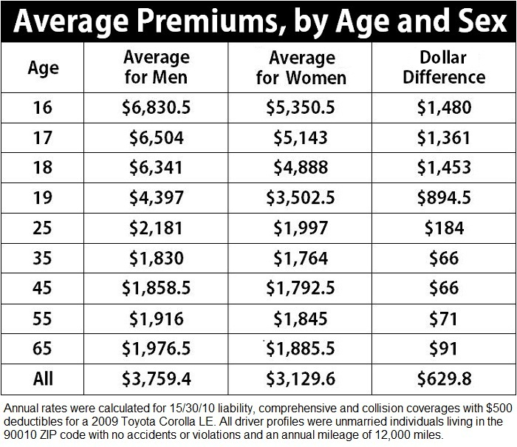
Car Insurance: Calculate your age based on the level of education your job requires – if none, you are 18, just finished high school

Slide 6
Other Costs
Entertainment?
Health insurance (would your job cover it?)
Medical care, miscellaneous items, etc.

Slide 7
Opening Activity – no slip necessary
What constitutes most of your monthly costs at the moment for your character?
Has your character factored in health insurance? Anyone who owns a small business, is part time, or doesn’t work for the government or a major corporation should factor in the cost of health insurance.
Did your character go to college? If yes, add in $5,000 worth of debt for each year they attended.

