Slide 1
Week 25 notes

Slide 2
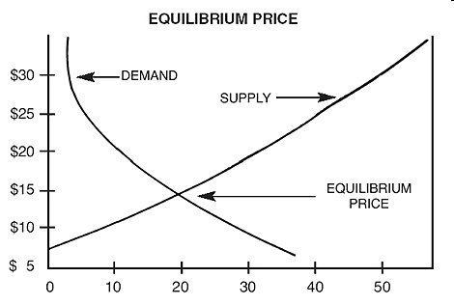
Supply and Demand Interact
Equilibrium price (EP): the price at which the quantity of a product demanded by consumers and the quantity of a product supplied by producers is equal

Slide 3
Surplus
Quantity supplied (QS) is greater than quantity demanded (QD)
Ex. Overstock stores
surplus

Slide 4
Shortage
Quantity demanded (QD) is greater than quantity supplied (QS)
Ex. Beyoncé concert tickets
shortage

Slide 5
App1
Graph the following situations:
When the Segway was first invented, many people thought it would explode to become the next major form of transportation and the investments came pouring in. Sadly for Segway’s founder, this did not come to be. Graph this situation.
During the 1970s, the U.S. was in a diplomatic crisis with the Middle East, a region that was supplying the country with most of its oil. People waited in long lines to get gas and gas stations were frequently running out. Graph this situation.

Slide 6
Disequilibrium
Disequilibrium occurs when there is a difference between QD and QS
often caused by shift in S or shift in D
Goes away once EP is found again
If D increases or S decreases, EP goes up
If D decreases or S increases, EP goes down

Slide 7
App 2
Price per Movie Ticket | Quantity Demanded | Quantity Supplied
$5 | 1000 | 10
$6 | 900 | 200
$7 | 600 | 400
$8 | 500 | 500
$9 | 300 | 700
$10 | 10 | 1000
Using the supply and demand schedule above, draw the 2 curves
2. What would equilibrium price be? Mark it on your graphs with a star.
3. What would happen to equilibrium price if demand increased?

Slide 8
App 2 - Economics Paragraph
You are considering starting a company and becoming a supplier of a good of your choice.
Describe in a well-written paragraph what you will have to take into consideration when making that choice.
You should use at least 8 of the following economic terms:
Supply, quantity supplied, marginal product, increasing returns, diminishing returns, variable costs, fixed costs, total costs, marginal revenue, marginal costs, profit-maximizing output, elasticity (inelastic/elastic), input costs,

Slide 9
Price System Interventions
When a government or supplier intervenes in the market and changes the natural workings of supply and demand to determine prices

Slide 10
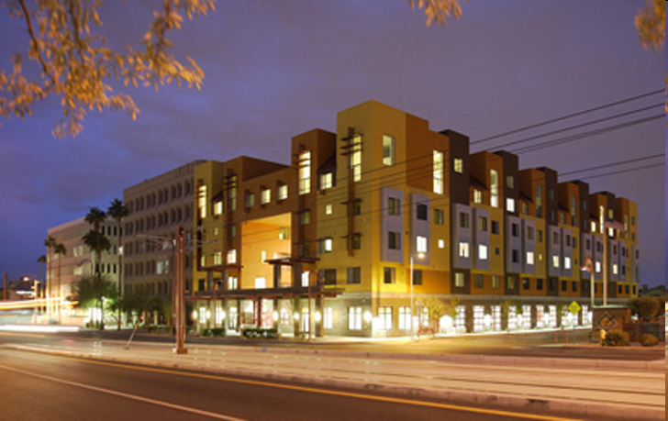
Price System Interventions
1. Price ceiling: max price at which a good can be sold
Can be set by govt (Ex.: rent control in low income housing)
By producers (Ex: university football tickets)

Slide 11
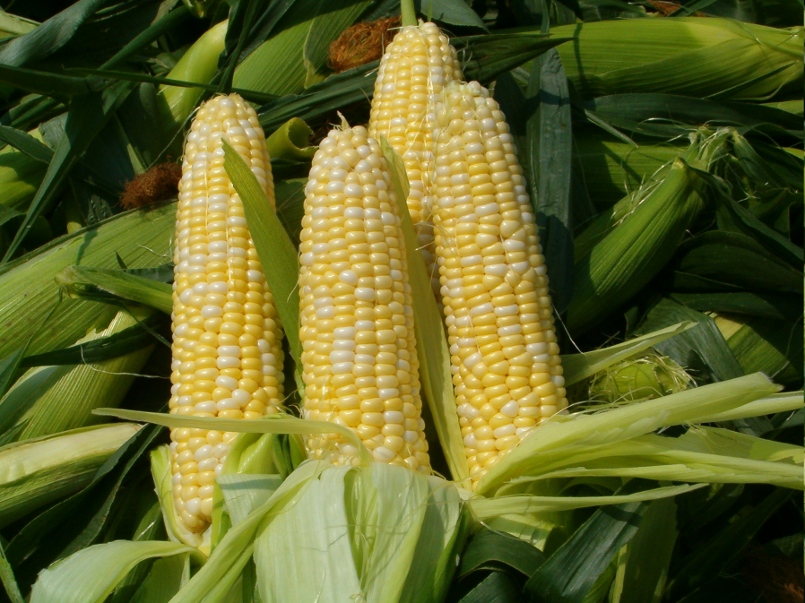
Interventions in Price Systems
2. Price floor: min price for a good
Ex. Minimum wage, corn

Slide 12
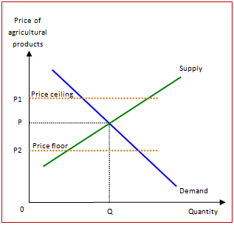

Slide 13
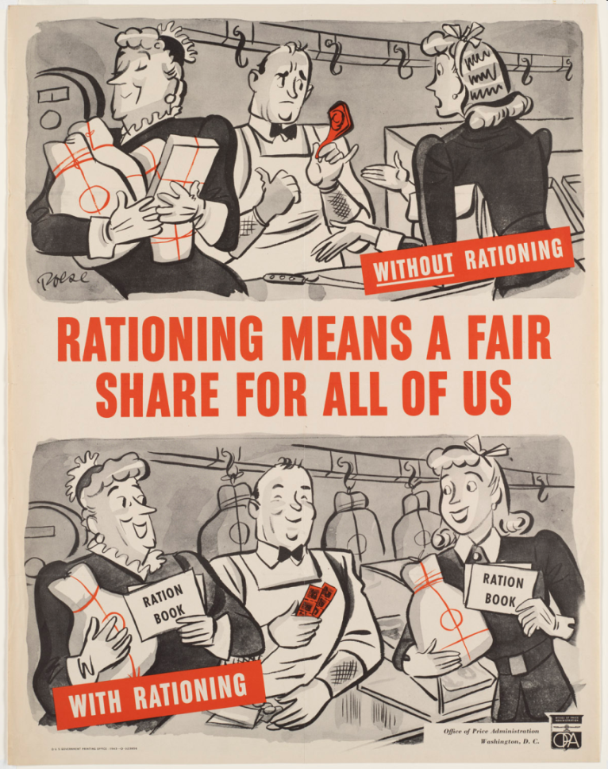
Interventions in Price System
3. Rationing – govt. restricts resources
Ex. Used during wars, Depression

Slide 14
Interventions in Price System
4. Black market: illegal market
Ex. Torrents

Slide 15
App3: Is this a price intervention? If yes, which one?
There is high demand for chocolate and so Nestle raises prices on candy bars.
The U.S. has a minimum wage law.
Blockbuster was unable to compete with Netflix and went out of business.
Many musicians worry about being able to make profits when so much music is illegally shared on the internet.
Louis CK wanted his recording of his latest comedy performance to be affordable to a large number of fans so he released it himself on the internet for $5.
During Prohibition, alcohol was still widely consumed.
North Korea’s communist system attempts to evenly distribute food amongst its population.
Syracuse University football tickets are sold for affordable prices so students can afford them. However, that means they sell out quickly, so you can often find people outside the stadium scalping tickets for 3 to 5 times their actual price on game day.

Slide 16
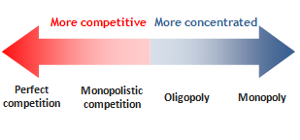
Market Structures
Market structures: economic model used to examine competition

Slide 17
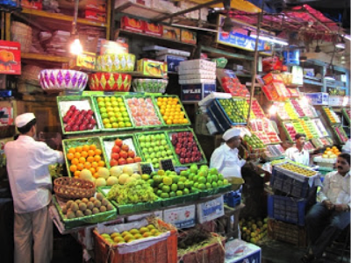
Market Structures
Perfect competition: ideal model
Numerous buyers and sellers
Standardized product
Freedom to enter/exit market
Independent buyers and sellers

Slide 18
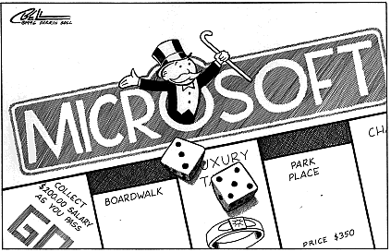
Market Structures
Monopoly – least competitive market structure
only one seller for a product with no substitutes
can set prices
large barriers to entry
Ex. Water company, Microsoft
Most markets = somewhere between monopoly and perfect competition

Slide 19
App 4
-In books, turn to pg. 200. Read the article on OPEC and answer the Connecting Across the Globe questions below.

