Slide 1
Notes Week 1: 8/31-9/4

Slide 2
Government Defined
the institution through which a state maintains social order, provides public services, and enforces decisions that are binding on all its residents

Slide 3
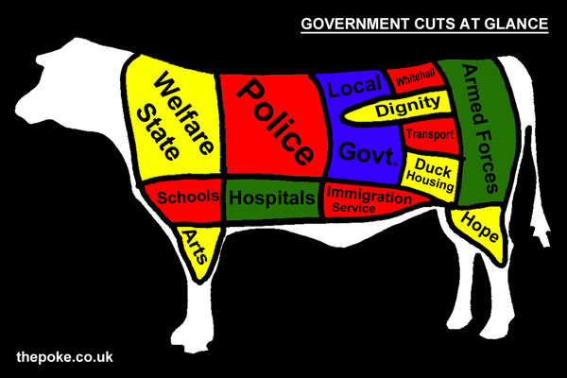
Purposes of Govt
Maintain social order
Ex. Laws, police force
Provide public services
Ex. Roads, sewers, etc.
National security
Ex. military actions, diplomacy
Economic decision-making
Ex. Regulate pollution, taxes

Slide 4
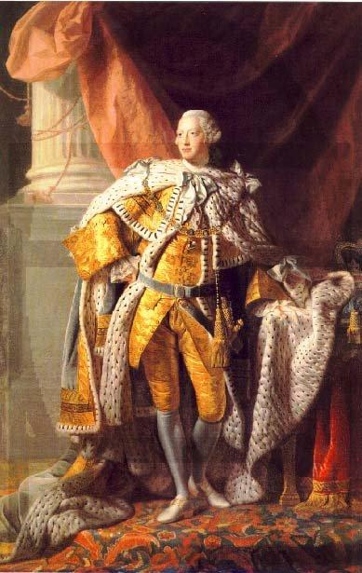
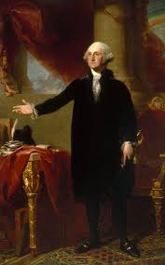
Founding of US Govt.
US controlled by Great Britain under King George III
No representation in Br. Parliament
Declaration of Independence – July 4, 1776
Monarchy is tyranny
People have rights to life, liberty, pursuit of happiness

Slide 5
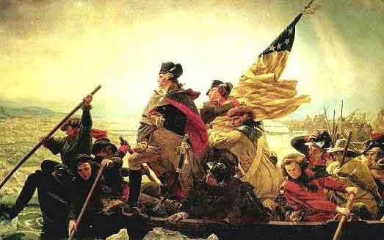
Founding of U.S. Govt
Revolutionary War – war of U.S. independence fought between American colonists and British
Americans win
Want to establish a republic – government where power rests in elected representatives

Slide 6
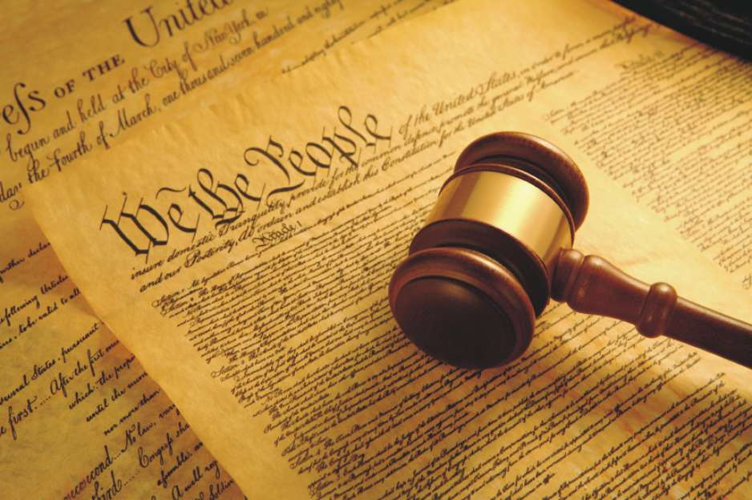
US Constitution
Constitution: a standard set of laws by which a government is established

Slide 7
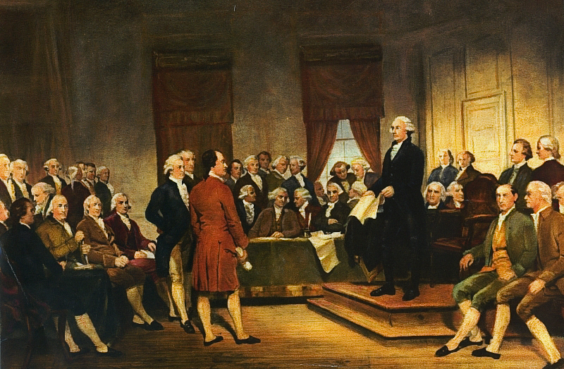
US Constitution
Creates balance of power
Between federal and state
govts: federalism
Between 3 branches of govt
Between people and govt
Establishes rights of citizens
Explains how govt completes necessary tasks

Slide 8
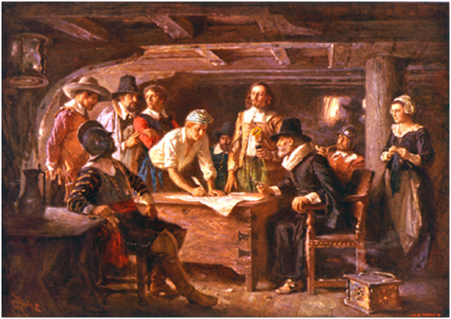
US Constitution
Origins and Influences on U.S. governance:
Enlightenment ideas – reason, logic over faith
John Locke – life, liberty, property
Magna Carta: British document – 1215
Guarantees basic rights to citizens
Mayflower Compact: signed by Puritan Separatists on reaching New World - 1620
Establishes precedence of self-government

Slide 9
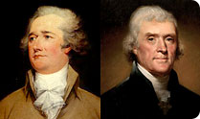
US Constitution
Fundamental argument: who gets more power, states or the federal govt?
Thomas Jefferson: state power
Alexander Hamilton: federal power
lays out ideas in Federalist Papers

Slide 10
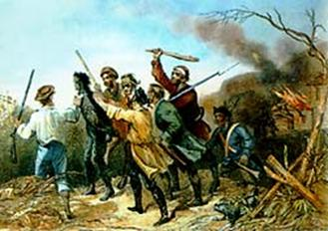
US Constitution
Articles of Confederation = first draft of Constitution
Jefferson perspective dominates
Very little federal authority
Shay’s Rebellion sends writers back to the table
Fed. Govt lacks basic power to collect taxes, quell rebellion

Slide 11
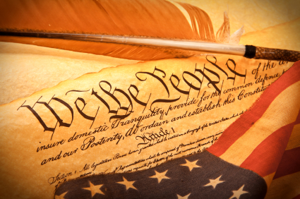
US Constitution
Constitutional Convention called – 1787
Some say new Constitution gives too much federal power
Solution: Bill of Rights added as compromise
first 10 Amendments to Constitution
Basic rights of individuals and states

