Slide 1
Week 19 notes

Slide 2
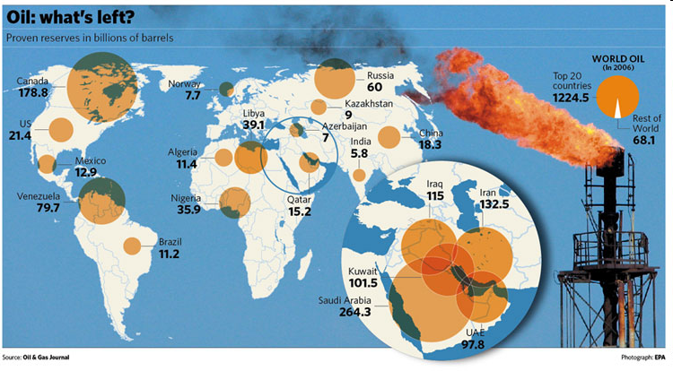
The Fundamental Economic Problem
World has limited resources
People have unlimited wants
Creates scarcity: not enough resources to meet human wants

Slide 3
The Basics
-Economics is the study of how people choose to use scarce resources to satisfy their wants and needs

Slide 4
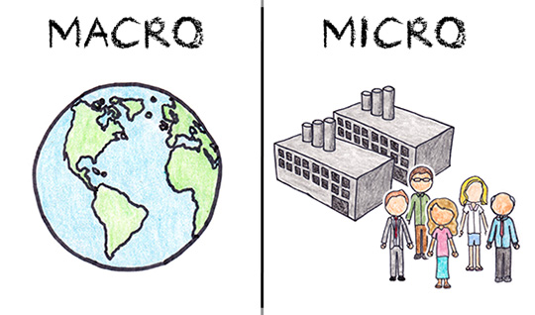
The Basics
Microeconomics: how do individual players interact in the economy
Ex: supply and demand
Macroeconomics: how does the economy as a whole function
Ex. Inflation

Slide 5
The Basics
Economies are divided into producers and consumers
Producers make things
Consumers buy things
Economies can produce goods or services
Goods: physical items
Services: work performed

Slide 6
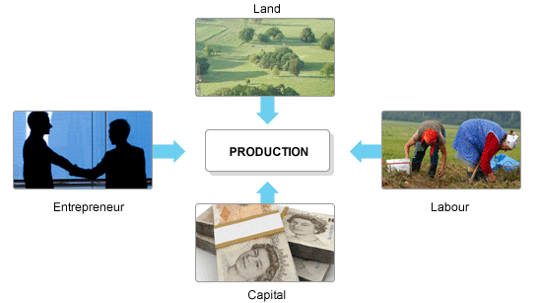
The Basics
Economies decide what to produce based on the Factors of production:
Land: what natural resources do we have?
Water, space, wildlife, etc.
Labor: What kind of workers do we have?
Educated or not, skills, etc.
Capital: What other stuff do we have?
Tools, machinery, roads, electricity, etc.
Entrepreneurship: Do we have people with ideas and vision who are willing to take risks
and start businesses?

Slide 7
Ex: The United States
Land: plentiful and cheap natural gas, large expanses of space in west, large thriving cities
Labor: large educated workforce, migrant laborers
Capital: strong banking industry, lots of access to manufactured goods from other countries
Entrepreneurship: lots of people with leisure time to come up with new ideas, support for creativity in education
Result: a largely services based economy but with some agriculture and extraction industries (ex: natural gas)

Slide 8
Application 1:
Country X:
Land: Very little arable (farmable) open land, a few large cities, access to cheap energy and textiles (fabrics)
Labor: very few educated workers, largely unskilled labor force
Capital: some access to foreign capital, weak banking system
Entrepreneurship: Many people are very poor and therefore risk-averse (afraid of risk)
What do you think the economy of this country will look like? Will they probably create mostly goods or services? What kinds of services might they create? Why?

Slide 9
Opening Activity
South Sudan is a new country and they have to establish their economy. They have fertile soil and are mineral rich, so they will probably attempt to have an economy focused mostly on agriculture and mining.
Will South Sudan have a goods or service economy if they pursue this route?
It’s 10 years down the road and South Sudan has begun to invest heavily in their education system. How does this change the factors of production for their economy? Which factors in particular does it change?

Slide 10
Economic Choice
How we decide:
Weigh costs (negative outcomes) and benefits (positive outcomes)
“No such thing as a free lunch” – every choice has costs
Look at incentives: benefits offered to encourage certain behaviors
Ex. Grades in school, sales
Consider utility: inherent benefit gained from a good or service, usefulness
Ex: phone may be costly but it’s utility is immense

Slide 11
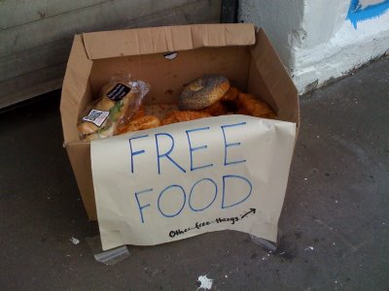
Economic Choice
Consider opportunity costs: the value of the next-best alternative, the choice you didn’t make
Ex. Opportunity cost of college = working
Economize: weight costs and benefits to make a choice
Cost-benefit analysis: a t-chart that assesses costs versus benefits and aids in decision-making

Slide 12
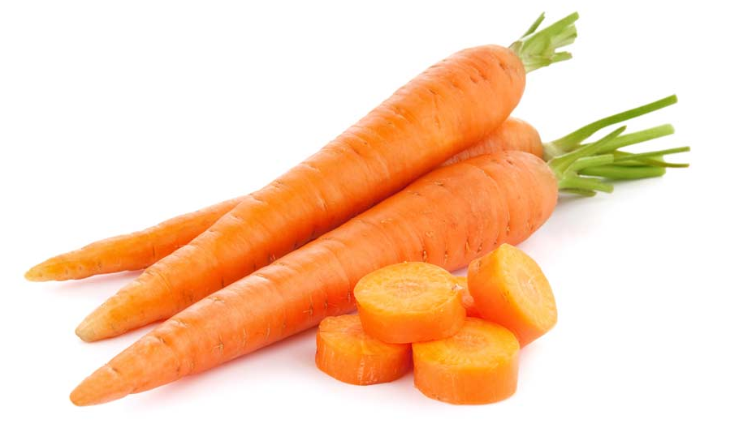
Economic Choice
Marginal cost - cost of using one more unit of a good or service
MC of 1 cheeto = 5 calories
Marginal benefit - benefit of using one more unit of a good or service
MB of 1 carrot = 50% of your daily Vitamin A
Must be measurable and specific

Slide 13
Application 2: Cost-Benefit Analysis
1. Create a cost-benefit analysis for going to college. What are the possible costs of going to college (monetary and otherwise)? The possible benefits?
2. Take a look at your list of costs and put a star next to any that might be considered opportunity costs.
3. Now finish these two sentences:
The marginal cost of going to college for one additional year is _____________________.
The marginal benefit of going to college for one additional year is ___________________.

