Slide 1
Week 15 Notes

Slide 2
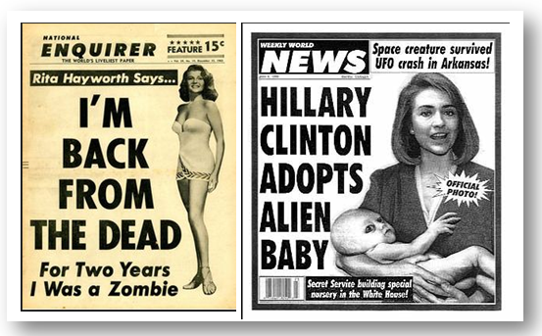
Influences on Voters
Media bias: When journalists and media companies allow their opinions to shape their coverage
Can be in what they choose to cover or how they cover it
Fake news: media inventing stories with partisan bias (bias toward 1 political ideology or another)

Slide 3
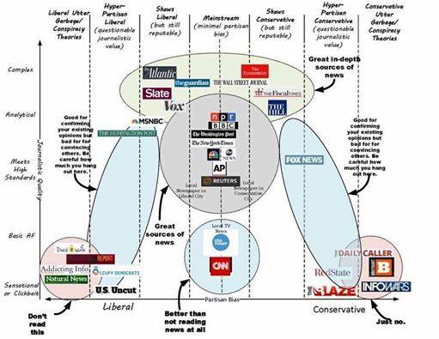

Slide 4
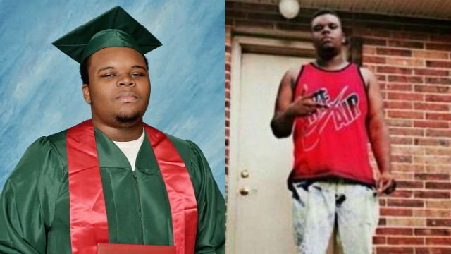

Slide 5
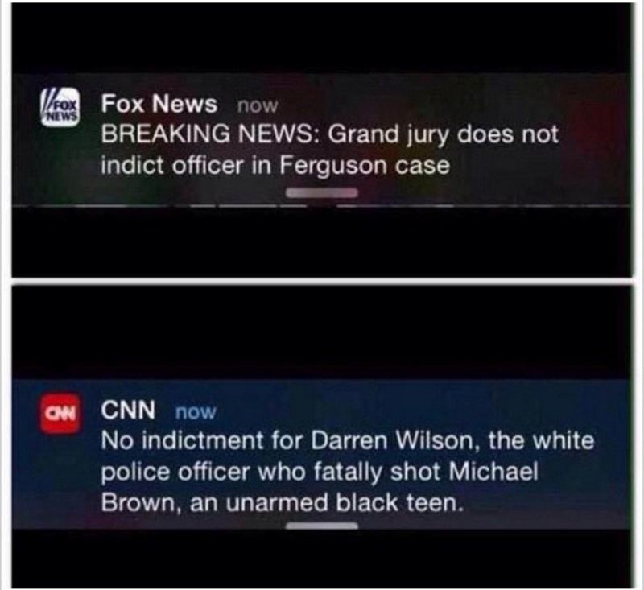

Slide 6
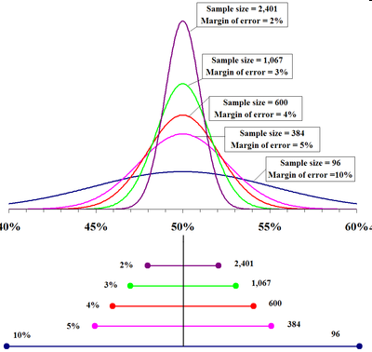
Influences on Voters
Polls – surveys that are conducted in order to predict election outcomes
Can convince people in later time zones not to vote
can suggest candidate has no chance, is going to win for sure
Margin of error: % by which poll may be wrong, often ignored
polls in last election failed to predict outcome

Slide 7
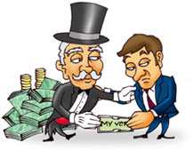
Influences on Voters
Interest Groups – outside groups that attempt to influence political leaders
Lobbyists: people paid to influence politicians on behalf of corporations, labor unions, other groups

Slide 8
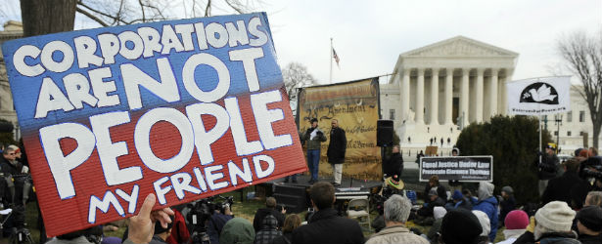
Influences on Voters
PACs and SuperPACs – Political Action Committees, fundraise for candidates and causes, are allowed to raise unlimited amounts of money
Only the case since a 2010 Supreme Court decision called Citizens United
Court found “corporations are people” and therefore have a right to free speech
Spending money = an expression of that free speech

Slide 9
Comparative Systems
Basic forms of government
Democracy
Autocracy
Oligarchy
Socialism
Communism

Slide 10
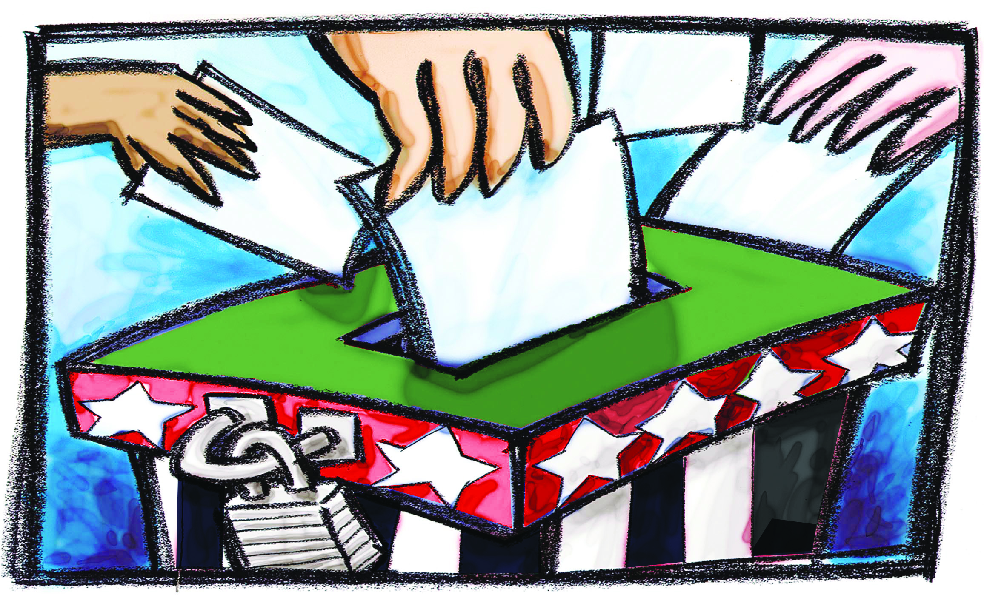
Democracy
Qualities of democracy:
Free and fair elections
Active participation of citizens in govt.
Protection of human rights
Equal application of laws to all
Majority rule
Ex. U.S., Europe, much of Asia/Latin America

Slide 11
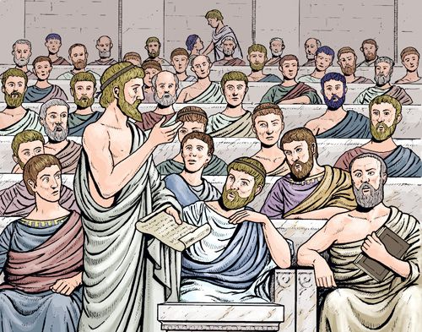
Democracy
Total democracy – citizens make all decisions collectively
Pro: all voices heard on all issues
Con: very slow, complicated
Ex. ancient Greece
Representative democracy – citizens elect representatives to make most decisions for them
Pro: more efficient, less complicated
Con: everyone may not feel represented
Ex. all modern democracies

Slide 12
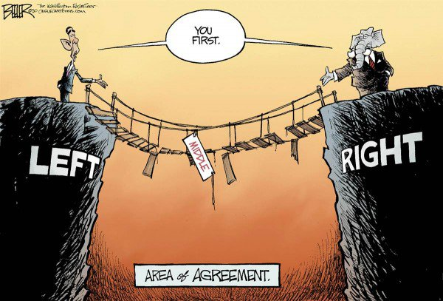
Democracy
Types of representative democracy:
1. presidential system – executive and legislature elected separately
Pros: checks and balances, harder for one party to control
Cons: gridlock – when nothing gets done in govt because parties can’t agree
Ex. U.S., Brazil

Slide 13
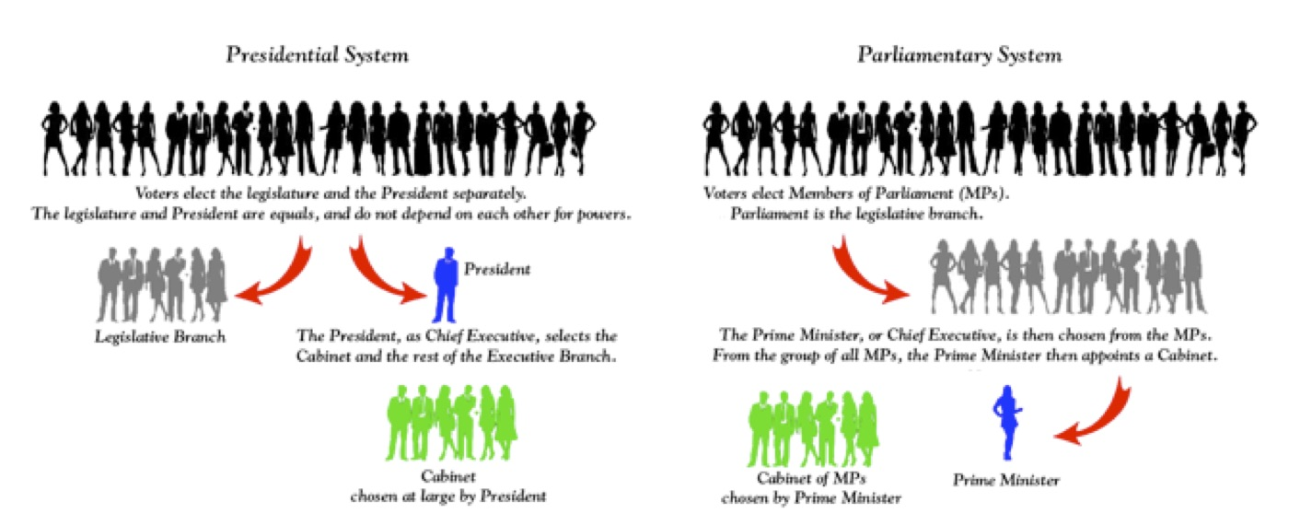
Democracy
2. parliamentary system – voters elect legislature, legislature chooses chief executive
Pros: executive more accountable, cooperation more likely
Cons: one party can push their agenda past minority groups
Ex. Britain, Canada, Japan

Slide 14
Parliamentary democracy
Presidential democracy

Slide 15
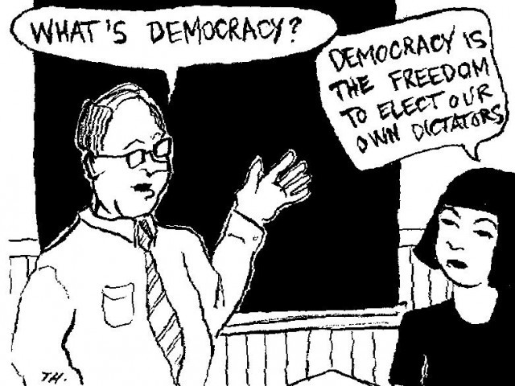
Democracy
Pros of democracy: people have say, greater freedom and equality
Cons: slow, corruptible

