Slide 1
Week 12 notes

Slide 2
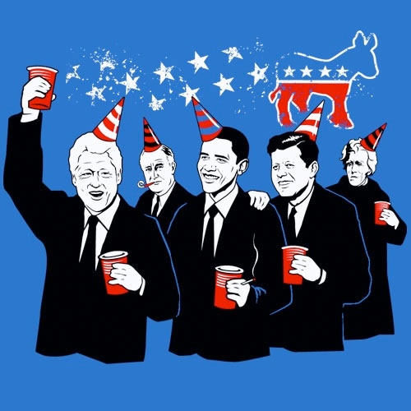
Political Parties
Political party – a group of people with broad common interests who organize to win elections, control government, and thereby influence government policies
Party platform: document that
lays out policies of party,
created during presidential
elections every 4 years

Slide 3
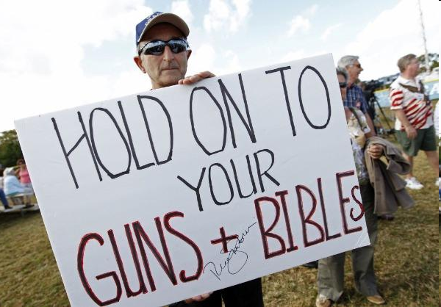
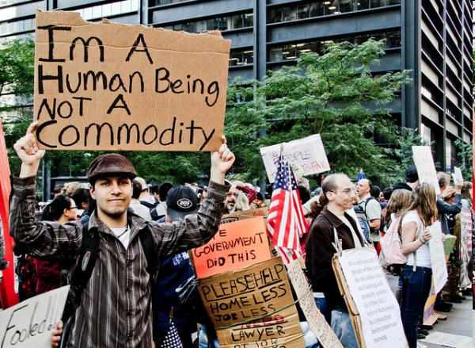
Conservative v. Liberal
Conservatism: “politically right”
Fiscal conservatism: small government, low spending
Social conservatism: anti-gay rights, pro-life
Liberalism: “politically left”
Fiscal liberalism: govt as force for good, pro-govt spending
Social liberalism: pro-choice, pro-gay rights

Slide 4
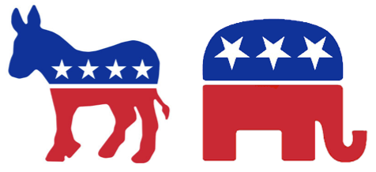
US Parties
U.S. = 2-party system – means we have 2 parties that are competitive at national level
Democrats
Republicans
Many Americans are Independent – don’t affiliate with a major party

Slide 5
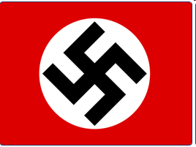
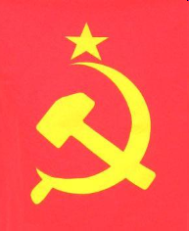
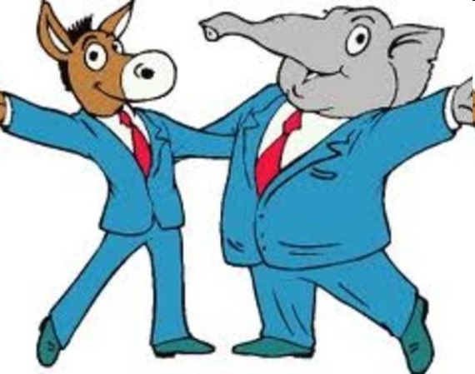
Where Our Parties Stand
Neo-Naziism
Democrats
Communism
Conservative
Republicans
Liberal

Slide 6
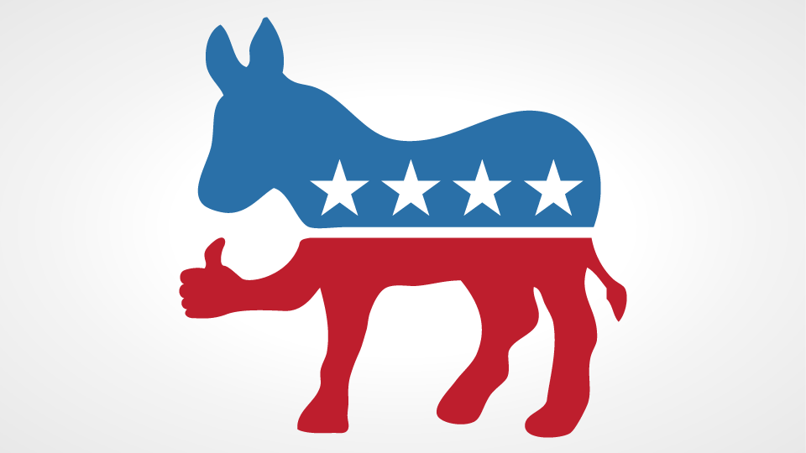
US Parties
Democratic Party:
Fiscally and socially more liberal
Support more government programs and regulation
Want higher taxes on wealthy, lower on middle class and poor – known as a progressive tax
Support gay marriage, abortion
Support universal health care
Symbol: the donkey
Color: Blue

Slide 7
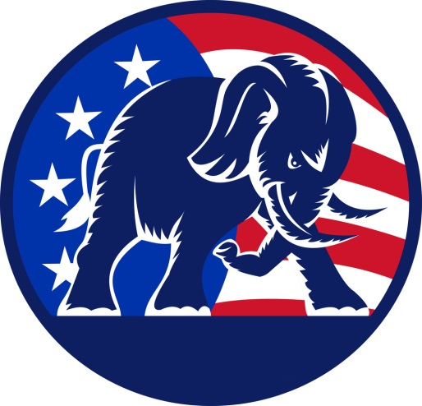
US Parties
Republican Party
More fiscally and socially conservative party
Want a smaller, less restrictive government
Want lower taxes across the board and for taxes to be equal – flat tax
Pro-choice (anti-abortion) and do not support gay marriage
Believe health care should remain a private industry
Symbol: the elephant
Color: Red

Slide 8
Opening Activity
Which political party is more liberal and what are some policies that prove they are that way?
Which is more conservative and what are some policies that prove they are that way?
What is the difference between fiscal and social issues?

Slide 9
OPENING
Poverty is increasing in the country because of a weak economy and wages not going up. How would Republicans suggest dealing with that problem? How might Democrats suggest dealing with it?
Mass shootings have increased substantially and people are concerned about their safety. How might Republicans seek to address this problem? Democrats?
Teenage pregnancy is becoming a problem in the country. How might Republicans try to fight this? Democrats?

Slide 10
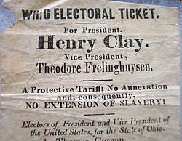
Origins of Our Parties
First parties = Federalists and Anti-Federalists
Federalists: pro-federal govt, pro Constitution as it is written
Anti-Federalists: anti-Constitution, pro-states rights, get Bill of Rights passed
Democratic-Republican Party formed with Thomas Jefferson, dominates country until…
Election of Andrew Jackson leads to a split of party, Democrats and Whigs = new parties

Slide 11
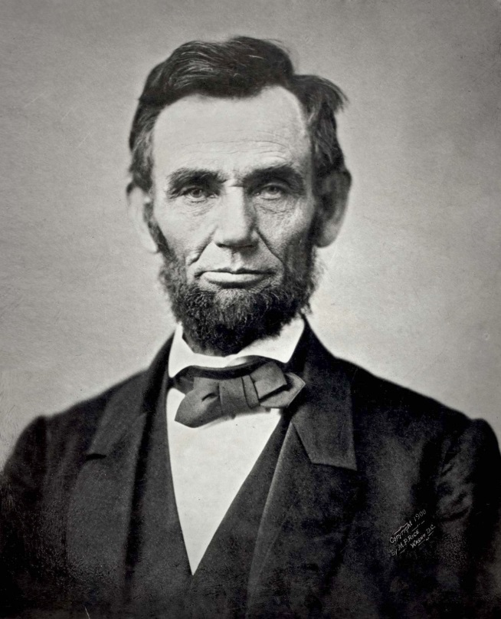
Origins of Our Parties
Debate over slavery divides both parties
Democrats split into Northern and Southern
Many Whigs join an anti-slavery party called The Republicans
Republicans come to dominate after Civil War (party of Lincoln)
Democrats dominate several decades after WWII (party of FDR)

