Slide 1
The 90’s to Today

Slide 2
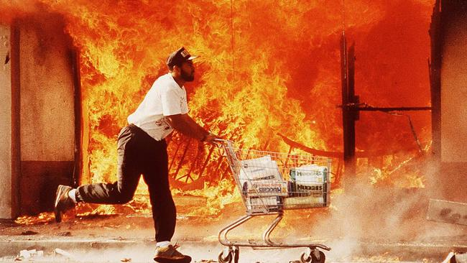
The 90’s to Today
George H.W. Bush - limited domestic agenda
Largest deficit in American history forces Bush to raise taxes despite pledge not to do so
Americans with Disabilities Act – 1990
Rodney King LA riots – black man arrested for speeding and beat by police – police acquitted

Slide 3
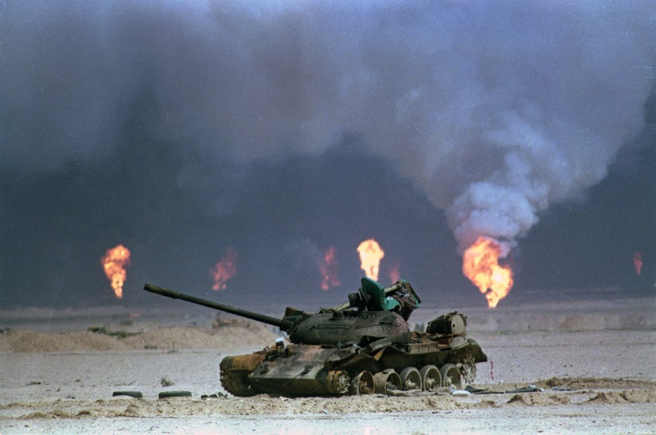
The 90’s to Today
GHW Bush: expanding US foreign influence
Soviet Union collapses due to revolts in satellite states
China cracks down: Tiananmen Square massacre
Panama – US invades to oust Manuel Noriega
Operation Desert Shield – 1st Gulf War
Iraq invades Kuwait, takes over oil fields
Operation Desert Storm ends war in victory after 42 days
US exits w/o unseating Hussein

Slide 4
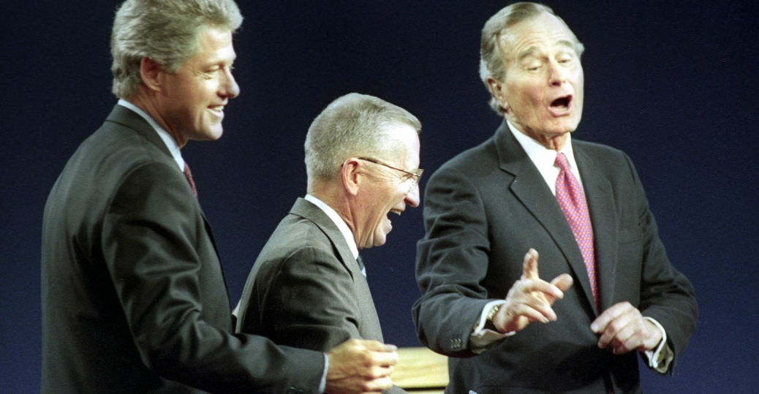
The 90’s to Today
Clinton – “New Democrats” take control
Socially liberal, fiscally conservative
1992 election – Ross Perot forms third party focused on ballooning deficit – 19% of vote
Clinton wins

Slide 5
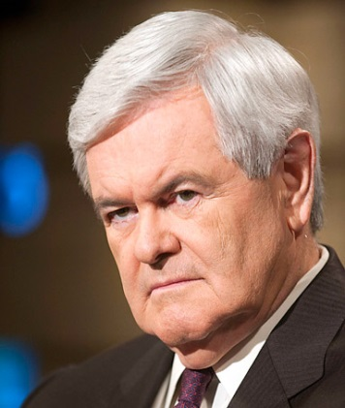
The 90’s to Today
Clinton – “New Democrats” take control
Reverses Reagan tax-cuts
Welfare-reform – reduce time families can be onwelfare
Balances budget
NAFTA lifts trade barriers between US, Canada, Mexico
Fails on universal health care, gay rights
“Don’t Ask, Don’t Tell,” Defense of Marriage Act
Stiff opposition from Newt Gingrich, House speaker

Slide 6
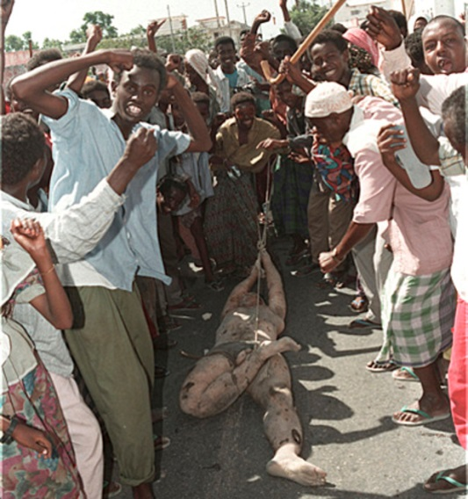
The 90’s to Today
Clinton – combatting ethnic cleansing
Somalia – civil war causes famine; US support lost after Black Hawk helicopter shot down, Americans killed, desecrated
No support for Rwandan genocide
Yugoslavia collapses – civil war between Croatia, Bosnia, Serbia
Serbia slaughters Bosnians – US intervenes

Slide 7
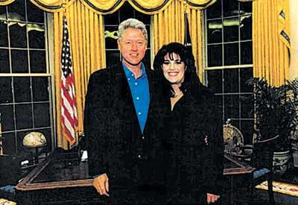
The 90’s to Today
Clinton’s Impeachment:
Lied under oath about affair with White House intern Monica Lewinsky
Obstruction of justice
House impeaches – Senate requires 2/3 to impeach, unable to do so
Strong economy, federal surplus, Clinton’s charisma maintain his popularity

Slide 8
The 90’s to Today
The Election of 2000
George W. Bush (R) v. Al Gore (D)
Ralph Nader – Green Party
Gore in lead for election but does not have 270 electoral votes to get win
Florida recount – hanging chads – partially punched ballots
Supreme Court halts recount and declares Bush winner

Slide 9
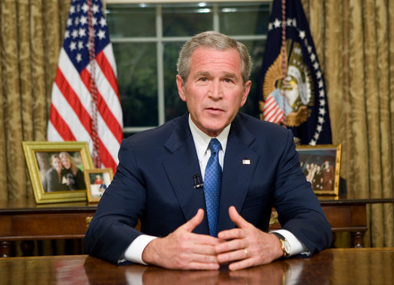
The 90’s to Today
George W. Bush – compassionate conservatism
Champion private initiatives to fix social problems
Tax cuts to wealthy, businesses
“No Child Left Behind” – federal funding to school determined by test performance

Slide 10
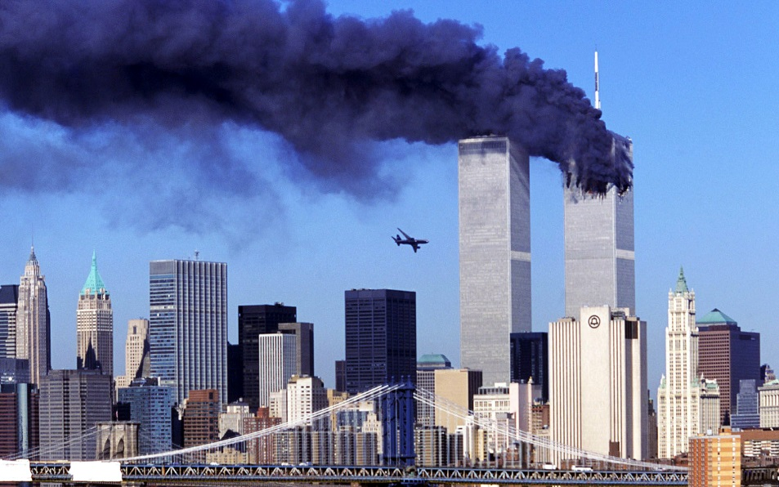
The 90’s to Today
George W. Bush – 9/11 and Terrorism
al-Qaeda attacks World Trade Center, the Pentagon
~3,000 killed
US immediately attacks Taliban govt. of Afghanistan for harboring al-Qaeda
2001 Patriot Act – expands govt investigative and police powers

Slide 11
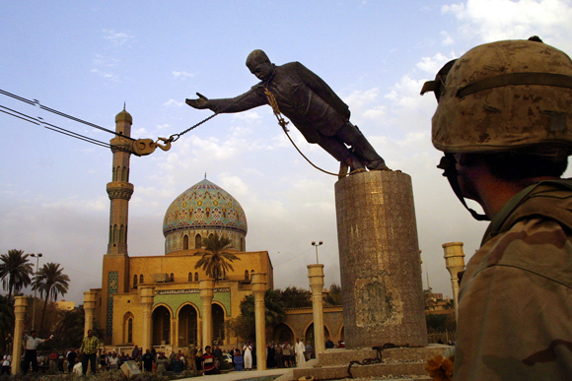
The 90’s to Today
Bush – the Iraq War
Preemptive war – attack them before they have chance to become dangerous – Dick Cheney architect
Bush Doctrine – US has unilateral right to go after any country harboring terrorists
Weapons of mass destruction = premise, never found
Quickly unseat Hussein after 2003 invasion, rebuilding much harder

Slide 12
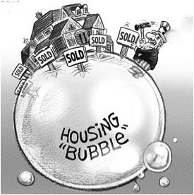
The 90’s to Today
The election of 2008 and the financial
crisis
Barack Obama (D) v. John McCain (R)
Obama: end Iraq War, roll back Bush tax cuts, McCain: keep both
2008: US housing bubble bursts
Risky trading of mortgage-backed securities leads to collapse of financial industry
Bush bails out banks
Obama wins presidency and faces worst economic crisis since the Great Depression

Slide 13
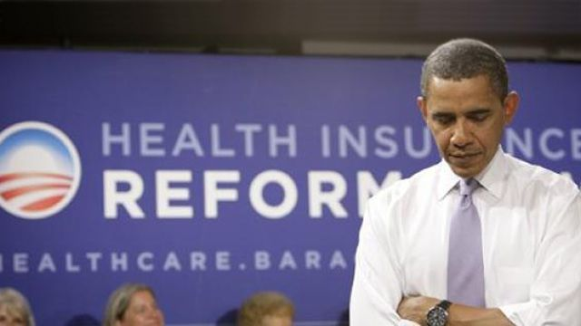
The 90’s to Today
Barack Obama – change and stalemate
Passes stimulus and Wall Street reform (Dodd-Frank) to address financial crisis
The Affordable Health Care Act “Obamacare”
Ends US wars in Iraq and Afghanistan
Increases power of regulatory agencies (FDA, EPA)
Steps to address climate change

Slide 14
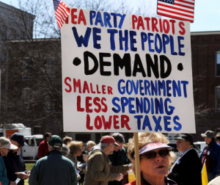
The 90’s to Today
2010 Congressional Elections and the rise of the Tea Party
Republicans sweep into power in the House in 2010, the Senate in 2012
Tea Party – strongly anti-tax, anti-govt, anti-establishment – “Freedom Caucus”
Led to govt shutdown for 2 weeks, 10/13

Slide 15
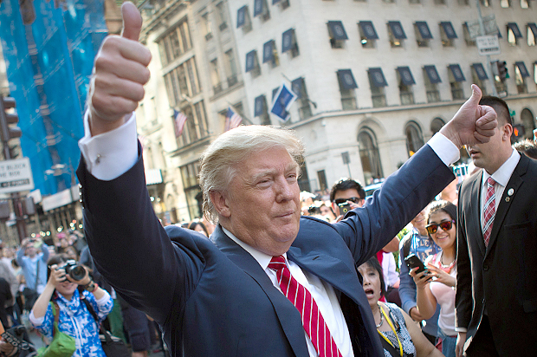
The 90’s to Today
The Election of 2016
Hillary Clinton (D) v. Donald Trump (R)
Hillary Clinton: Obama 2.0, moderate message, anti-Trumpism; Donald Trump: America first, anti-immigration
Dissatisfaction over slow economic growth, rural decline causes Trump message to resonate
Clinton wins popular vote, Trump the electoral college
Russian interference in US and European elections suggest re-emerging Cold War concerns

Slide 16
Quiz
How did American involvement in the Middle East expand under the 1st and 2nd Bush administrations?
Why is Bill Clinton considered a moderate? How did he differ from previous Democratic administrations?
Why was Bill Clinton impeached?
What major challenges did Barack Obama face during his administration?
Why were the elections of 2000 and 2016 similarly controversial in their outcomes?

