Slide 1
Week 7 Notes: 10/12-10/16

Slide 2
Division of Power
National powers: 3 types
1. Expressed: listed in Constitution
Ex: Coin $, declare war, regulate foreign and interstate (trade between states) commerce, raise army

Slide 3
Division of Power
2. Implied: not named, but spring from expressed powers
Elastic clause: says Congress can make all laws that are “necessary and proper” to carrying out expressed powers
Ex. Power to draft not listed, but implied by power to raise army
3. Inherent: not named, but necessary to be a govt.
Ex: control immigration, conduct foreign relations

Slide 4
Division of Power
State powers: called reserved powers
Powers not delegated to fed govt reserved for states
Ex. Regulate schools, regulate intrastate commerce (trade within a state), protect public welfare, administer elections

Slide 5
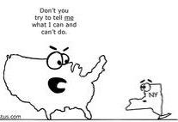
Division of Power
Concurrent powers – shared powers between states and federal govt
Ex. To tax, borrow $$, spend $$, pass and enforce laws
**Supremacy clause** - if federal and state law conflict, federal trumps state

