Slide 1
Week 27 Notes

Slide 2
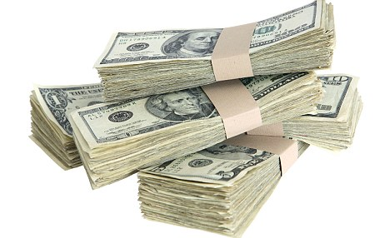
Money
Money: anything people accept as exchange for goods or services
3 functions:
Medium of exchange: used to exchange goods/services
Standard of value: as a yardstick to measure value
Store of value: a way to store, accumulate wealth

Slide 3
Money
Physical properties of money: durable, portable, divisible, uniform
Economic properties: stable value, scarce, acceptable

Slide 4
Money
Types:
Commodity money: derives value from type of material its made of
Ex. Livestock
Representative money: paper money backed by something tangible, like silver or gold
Ex. Gold standard
Fiat money: no tangible backing, worth is given by govt., citizens who use it
Ex. Most money today

Slide 5
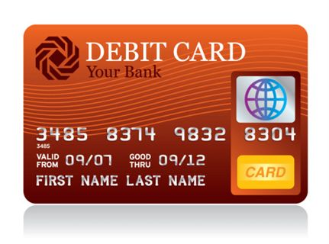
Money
Forms money takes in the U.S.:
Currency: physical money: paper money, coins
Demand deposits: can be converted into currency on demand, Ex. checking accounts
Near Money: not medium of exchange but easy to transfer into one, Ex. savings accounts, savings bonds

Slide 6
App 1: The Color of Money podcast
What do the podcasters criticize about US money?
What do they think is better about Australian money?
Why does US money look the way it does? What is it meant to convey?
What changes to US currency would you support and why?

Slide 7
Opening
Connect the terms on the left to the terms on the right:
Commodity money a. paper money
Representative money b. a potato
Fiat money c. a check
Currency d. savings account
Demand deposits e. U.S. money circa 1910
Near money f. U.S. money today

Slide 8
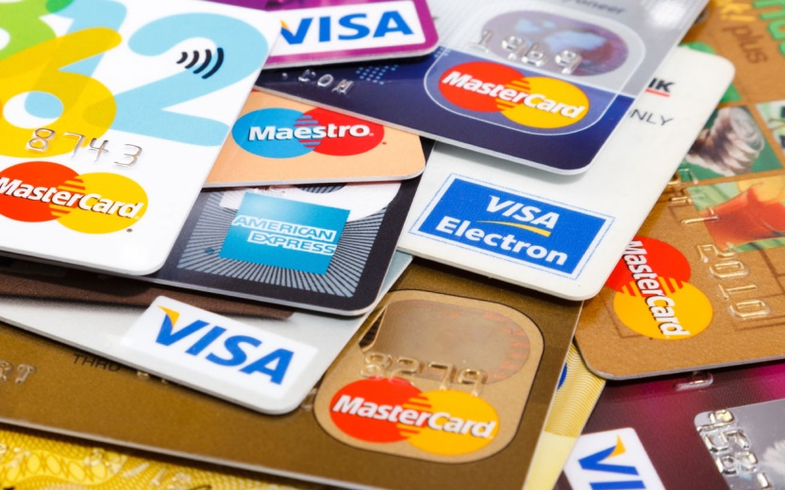
Banking
Purpose of banking: customers can store money, make money, borrow money
Fractional reserve banking: banks required to hold a percentage of the deposits they have
Can loan the rest
Ex. Credit card purchases = mini-loans
Reserve rate: % of $$ banks must hold on to; set by the central bank, or Federal Reserve
~10%

Slide 9
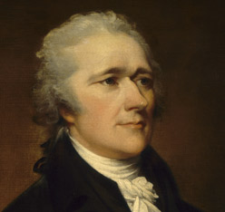
Banking
US Banking Timeline:
First, state banks, diff. currencies, currency not backed by anything
Wildcat banking – very unstable
1791 - Bank of the U.S. – Alexander Hamilton, Sec of Treasury - forces states to back currency
Many distrust federal bank
2nd Bank of US dissolved 1836 by A. Jackson
1863: National Banking Act creates national banks, national currency

Slide 10
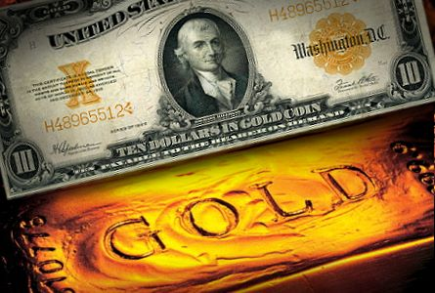
1900: gold standard adopted ($1=set amount of gold)
1913: Federal Reserve Act creates new central bank
Regulates money supply, loans to banks, etc.
1930’s: Great Depression reform
Federal Deposit Insurance Corporation – banks fails, you get your money
Securities and Exchange Commission – oversees stock market
End of gold standard
1980’s: deregulation – causes riskier moves by financial institutions
2008: financial crisis – housing bubble bursts

Slide 11
Savings and Investment
Savings: income not used for consumption
Investment: use of income today in a way that allows for a future benefit
Ex. Stocks, bonds, CDs, mutual funds, etc.
Risk v. rate of return
Savings account = least risky, lowest rate of return
Stocks = most risky, highest possible rate of return

Slide 12
Financial Markets
Stock Market:
Stock exchange: market where securities (stocks and bonds) are bought and sold
Investors earn dividends (share of corporate profits) and capital gains (earnings from selling stock at higher price than you bought it for)

Slide 13
Financial Markets
Stock Market, cont.
Biggest exchange: NY Stock Exchange (NYSE)
Online only exchange: NASDAQ – mostly tech stocks

Slide 14
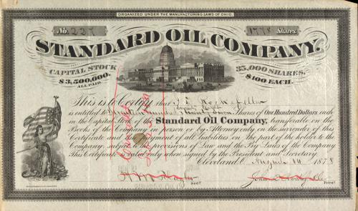
Financial Markets
Stock Market, cont.
Types of investments:
Stock: share of a company
Bond: loan to a company, the govt.
Future: contract to buy/sell stock at a future date at a set price (have to do it)

Slide 15
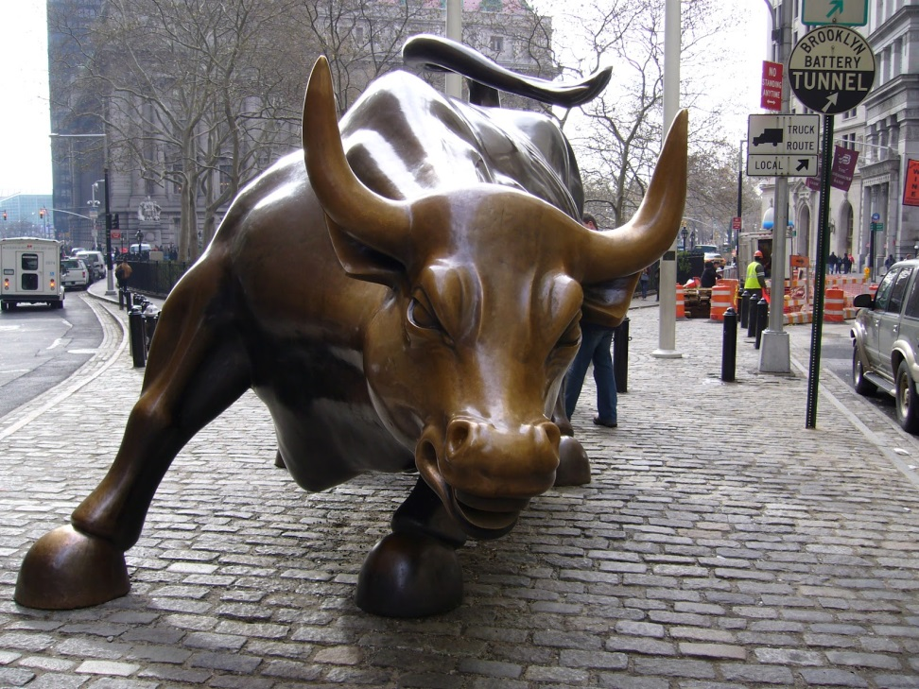
Financial Markets
Stock Market, cont.
Stock index: measures performance of stock market
Dow Jones, S&P 500
Bull market – stock prices are rising
Bear market – stock prices are falling

