Slide 1
Week 24 Notes

Slide 2
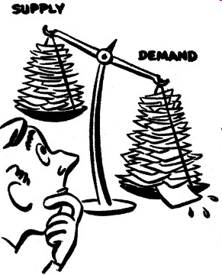
Supply
Supply: The willingness and ability of producers to offer goods and services for sale
Law of supply: producers are willing to sell more of a good at a higher price than a lower price

Slide 3
Supply
Supply schedule: Table showing how much of a good/service producers will sell at each price
Price per Avocado | Quantity Supplied
$.50 | 100
$1.00 | 200
$1.25 | 300
$1.50 | 400

Slide 4
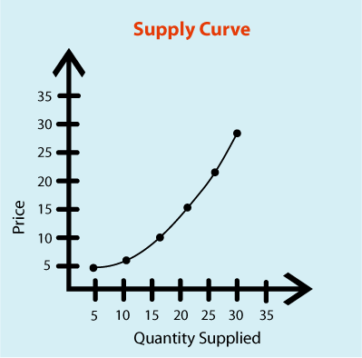
Supply Curve
Graph showing how much producers are willing to sell at any given price

Slide 5
Changes in Supply
Change in quantity supplied: change in amount producer is willing to supply due to price change
From 1 to 2
Change in supply: something prompts producers to offer different amounts for sale at every price
From A to B
A
B
2
1

Slide 6
Application 1
1. Create a supply schedule and a supply curve showing how many bananas a producer might be able to sell at 5 consecutive prices starting at $.50
2. Which are Colorado producers more likely to supply: bananas or peaches and why?
3. What does the law of supply say will happen if the price of a bananas goes up?
4. The price of bananas is currently $1.00. It goes up to $1.50. Graph the change and then write QS if this is a change in quantity supplied or S if it’s a change in supply.
5. A new device is invented to pick bananas and cost of production goes way down. Draw this change and label it QS if it’s a change in quantity supplied or S if it’s a change in supply.

Slide 7
App 2
Bookwork:
Pg. 134 Analyze Graphs 1-2
Pg. 147 Analyze Graphs 1-2
Pg 148 Analyze Graphs 1-2

Slide 8
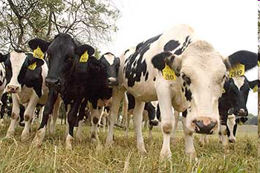
Factors of Supply
Input Costs: Price of goods needed to make a product
Ex. if feed prices increase, the supply of beef might decrease

Slide 9
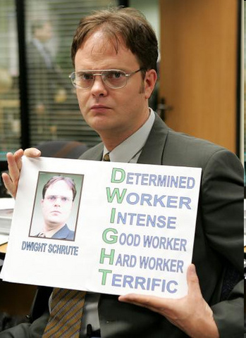
Factors of Supply
Labor Productivity: Level of efficiency of the labor force
Better trained, higher skill workers produce more
Ex. High turnover hurts labor productivity

Slide 10
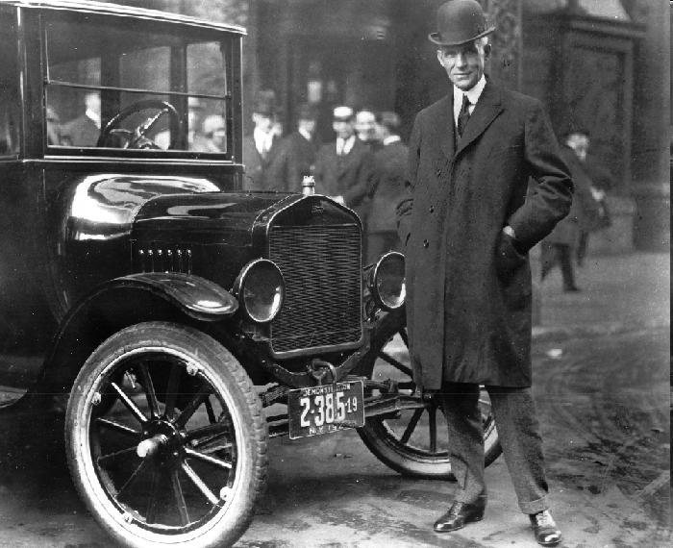
Factors of Supply
Technology: New techniques, production processes can increase productivity
Ex: assembly line

Slide 11
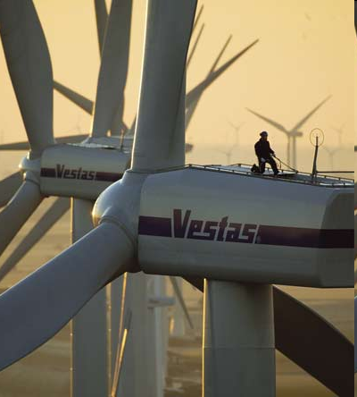
Factors of Supply
Government Action: govt intervention can raise/lower costs, increase/decrease supply
Ex. Subsidies (govt makes product cheaper) can help a product market
The green energy tax credit helped Vestas wind farm come to the U.S.

Slide 12
Factors of Supply
Producer Expectations: If producers expect prices to rise or fall, they may change their supply
If they expect prices to rise they will increase supply, vice versa
Ex. A farmer expects lettuce prices to drop, decreases supply so prices will go back up

Slide 13
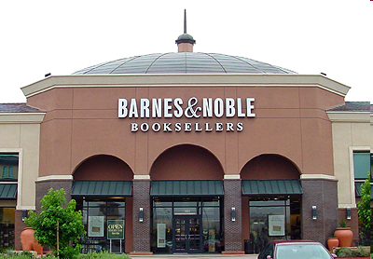
Factors of Supply
Number of producers: Competition affects supply
In a new market there is less supply, competition increases supply
Ex: If there are 2 bookstores in town and one goes out of business, supply decreases

Slide 14
App 3
1. Hobby Lobby goes out of business, decreasing the supply of crafting goods in Pueblo.
2. Genetically modified organisms (GMO’s) allow farmers to increase supply by minimizing waste.
3. The price of flour goes up causing Pizza Hut’s costs to increase, decreasing supply.
4. The government subsidy on corn increased the supply of corn-syrup-sweetened products.
5. New regulations on the Sriracha factory cause costs to increase, decreasing supply.
6. A union dispute leads to a worker lockout at a leather factory and the supply of leather jackets goes down.
7. San Francisco’s high minimum wage laws cause some producers to move out of the city and decrease the supply of fast food.
8. A marijuana grower expects another state to legalize the product and so they increase supply.
9. The price of lumber increases, causing costs of paper to go up and so the supply of paper decreases.
10. At the holidays many places hire seasonal labor to temporarily increase supply.

Slide 15
App 4
Create 2 scenarios of your own. You will select one to read to the class.

Slide 16
Production
What goes into a supplier’s decision on how much to produce?
Marginal product: change in production resulting from hiring one more worker
Increasing returns: when each new worker adds more total output than the last
Diminishing returns: when each new worker causes production to increase but at a decreasing rate

Slide 17
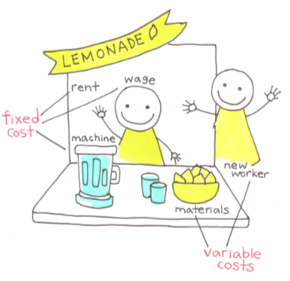
Production
Goal of business is to maximize profit, minimize costs
Fixed costs: expense a business owner incurs no matter what the level of production
Factory, insurance, CEO pay
Variable costs: expenses that shift depending on level of production
Wages, materials
Total cost: fixed + variable
costs
Marginal cost: cost of
producing one more unit

Slide 18
Production
Marginal revenue: price
Total revenue: price times quantity
Profit-maximizing output: when marginal cost and marginal revenue are equal

Slide 19
App 5
Bookwork
Pg. 139 Analyze Tables 1-2
Pg. 141 Analyze Tables 1-2
Pg. 143 Analyze Tables 1-2

Slide 20
Opening Activity
Draw a supply curve for apples
Price goes up. Graph the change that would occur as a result
The apple grower is hiring laborers. 1 laborer can pick 100 apples, 2 together can pick 210, 3 can pick 500, 4 can pick 700, and 5 can pick 800. How many workers will they hire and why?
What might a variable cost of owning an apple orchard be? A fixed cost?

Slide 21
Opening Activity
Is a stuffed animal a normal good or an inferior good?
Is the demand for a stuffed animal elastic or inelastic?
Draw a supply curve for stuffed animals and mark a point on the line to indicate current price.
The price is raised by $1, draw what that would look like and label it #1.
Toys ‘R Us goes out of business. Show what would happen on your graph and label it #2. Explain what factor of supply caused the shift.

Slide 22
Elasticity of Supply
Elasticity of supply: How responsive are producers to a change in price
Elastic supply: producers are able to quickly increase/decrease supply when price changes
Ex. Clothing, plastics
Inelastic supply: producers are unable to quickly increase/decrease supply when price changes
Ex. Oranges, cars

Slide 23
App 6: Elasticity of Supply: Elastic or Inelastic supply?
A boot company
A banana plantation
Computer company
These next 2 scenarios look at LABOR supply:
A firm wants to hire engineers in Pueblo and there are few trained people. Engineering is a 4-year degree.
McDonalds is looking to hire a bunch of minimum-wage cashier positions.
South High needs to hire a new Economics teacher.

