Slide 1
Notes Week 30

Slide 2
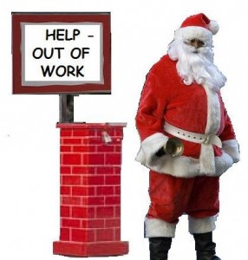
Economic Challenges
Unemployment
Types:
Frictional unemployment: unemployment caused by switching jobs
Seasonal unemployment: only work for part of year
Structural unemployment: jobs
exist, but workers don’t have skills
needed
4. Cyclical unemployment: caused by
contraction in economy

Slide 3
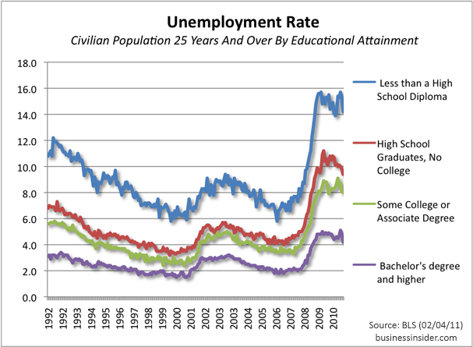
Economic Challenges
Unemployment
Unemployment rate: the percentage of labor force that is jobless and actively looking for work
Doesn’t count underemployed, those not looking
Full employment:
no unemployment
caused by
decreased
economic activity,
not 0%
-seasonal, frictional,
structural don’t
count against

Slide 4
App 1
Write a scenario for each form of unemployment to illustrate what that type of unemployment looks like:
Frictional unemployment
Seasonal unemployment
Structural unemployment
Cyclical unemployment

Slide 5
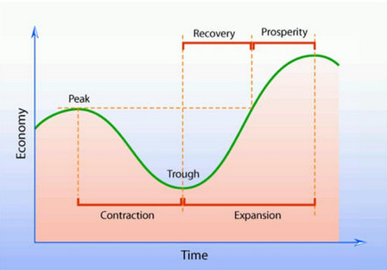
Business Cycles
Business cycle – a series of period of expanding, contracting economic activity
4 stages
Expansion: real GDP goes up, unemployment down, etc.
Peak: highest real GDP
Contraction: GDP down
Recession: contraction of 6 months or more
Depression: extended recession
Trough: real GDP and
employment stop declining

Slide 6
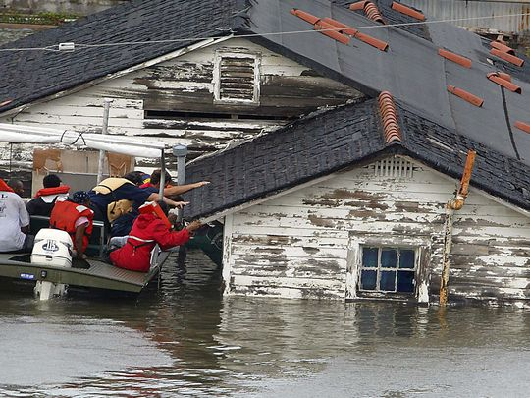
Business Cycles
Why it occurs:
Business decisions
Ex. Sending jobs overseas
New technology
Ex. The tech boom
Interest rates: cost of borrowing money
high interest rates, fewer people starting businesses, buying houses, etc.
Consumer confidence
Ex. Presidential elections
External Issues
Ex. Natural disasters

Slide 7
Business Cycle
Predicting the Business Cycle:
Leading indicators: measures of economic performance before real GDP changes
New building permits
Orders for goods
Coincident indicators: measures that usually change at the same time as GDP
Employment, sales, income
Lagging indicators: measure that isn’t apparent until after real GDP changes
Length of unemployment

Slide 8
App 2: Is this a leading, coincident, or lagging indicator
Pueblo restaurants report that sales are down.
Wages were stagnated (not rising) or declining for most of 2008-2010.
More people than ever are investing in the stock market.
Paper suppliers report that new orders are down 25%.
Average length of unemployment was at its greatest level in a decade in the spring of 2009.
Now draw a business cycle. Label the 4 stages. Then put a number 1-4 at the point where the indicators above might have occurred.

Slide 9
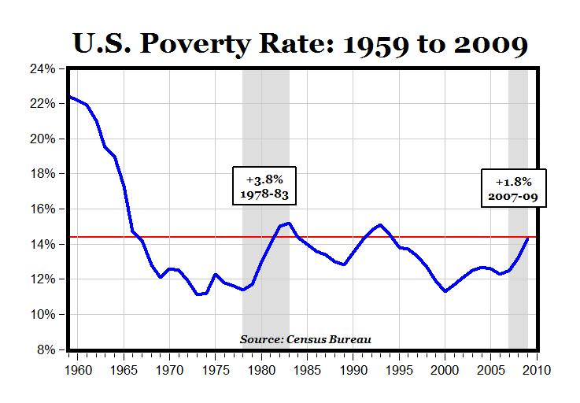
Economic Challenges
Poverty: when people lack resources to meet basic needs
Poverty threshold: minimum income needed to meet basic necessities in U.S.
for 4-person household with 2 adults, $24,300
For 1 person - $11,880
Poverty rate: percentage of people living below poverty threshold
14.5% currently

Slide 10
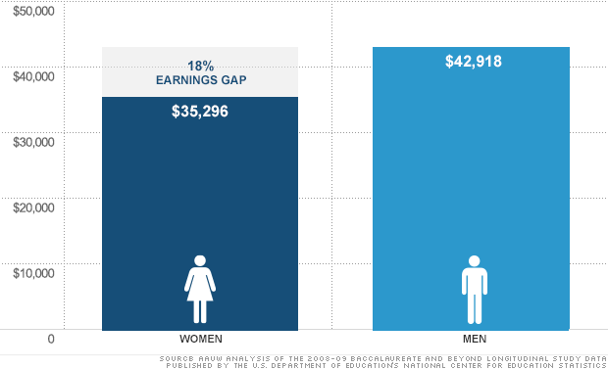
Economic Challenges
Poverty
Factors:
Education: higher education = higher income
Discrimination: White males earn more than women, minorities
Demographic Trends: growth of single parents, increase in immigration, etc.
Changes in labor
force: loss/gain of
high income fields

Slide 11
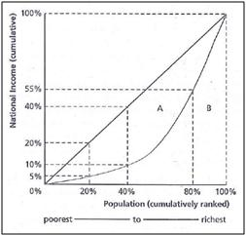
Economic Challenges
Income Distribution and Poverty
Income inequality: unequal distribution of income
High in US – median income high, poverty also high
Lorenz curve: illustrates income distribution

Slide 12
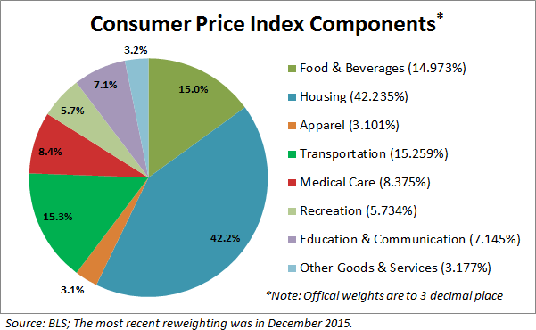
Economic Challenges
Inflation: continuing rise in prices, lowering in purchasing power of money
Measuring inflation:
Consumer Price Index: measures changes in prices over time
Surveys show what consumers buy
Govt creates “market basket” of 400 standard goods
Calculate percentage of
household budget that goes
to each item

Slide 13
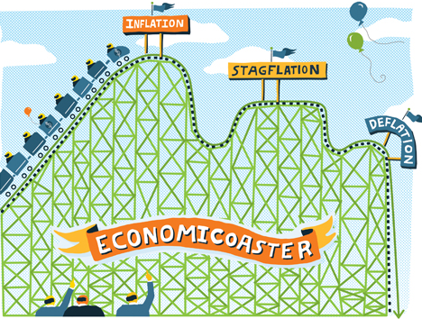
Economic Challenges
Degrees of inflation
>1% is good, 1-3% OK
Hyperinflation: rapid, uncontrolled; >50% per month
Deflation: decrease in prices, means economy is shrinking

Slide 14
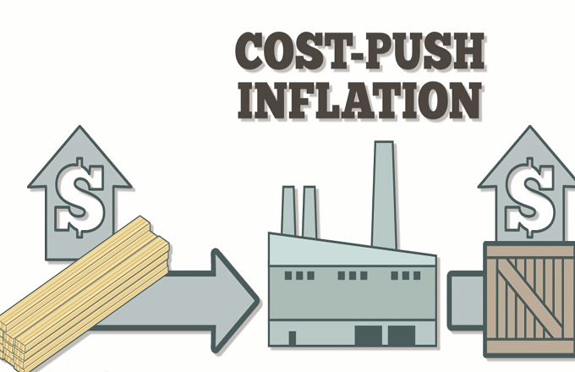
Economic Challenges
Causes of Inflation:
Demand-pull inflation: demand rises faster than production causing scarcity, rising prices
Cost-push inflation: increase in production costs causing higher prices

Slide 15
The CPI and Inflation – App 3
Grab a Chromebook and go to www.bls.gov/cpi
Scroll down to the CPI Databases and click on the PDF link for the “Current CPI Detailed Report”. Scroll to page 68 and find the 1915 CPI. Then scroll down to page 71 to find the most recent CPI. To determine our inflation divisor: CPI2017/CPI1917
Now complete the following:
Find the price of 5 goods you buy now and determine what they would have cost in 1917 (price now/inflation divisor).
Now find the average salary for a career you are interested in and determine what an equivalent salary would have been in 1917.
Lastly, find the average cost of a house in a place you might want to live and determine what that house would have cost in 1917.

Slide 16
Financial Markets
Stock Market:
Stock exchange: market where securities (stocks and bonds) are bought and sold
Investors earn dividends (share of corporate profits) and capital gains (earnings from selling stock at higher price than you bought it for)
Stockbroker: agent who receive commission for buying and selling securities for others

Slide 17
Financial Markets
Stock Market, cont.
Biggest exchange: NY Stock Exchange (NYSE)
Online only exchange: NASDAQ – mostly tech stocks

Slide 18
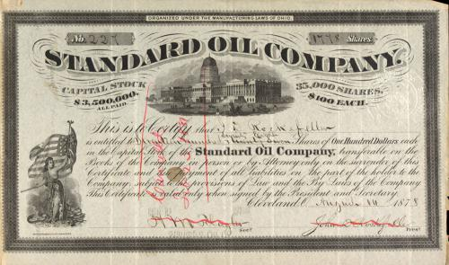
Financial Markets
Stock Market, cont.
Types of investments:
Stock: share of a company
Bond: loan to a company, the govt.
Future: contract to buy/sell stock at a future date at a set price (have to do it)
Option: contract giving investor the right to buy/sell stock at a future date at a set price (don’t have to do it)

Slide 19
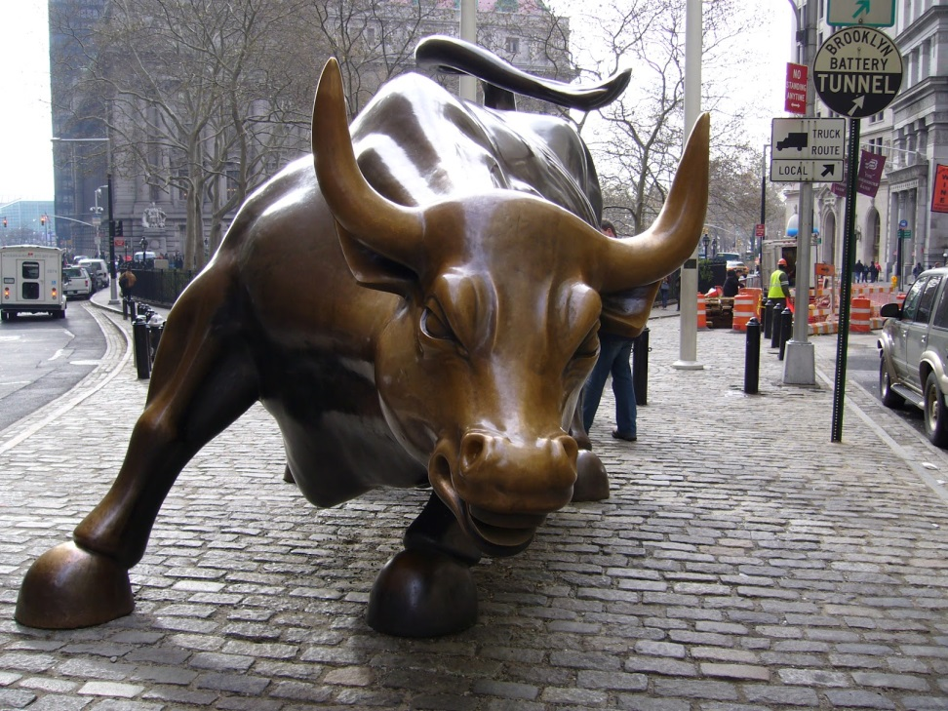
Financial Markets
Stock Market, cont.
Stock index: measures change in stock market
Dow Jones, S&P 500
Bull market – stock prices are rising
Bear market – stock prices are falling

